Slide 1


CONSORTIUM MEETING
BETWEEN
NIFRA BANK AS A LEAD BANK
NIC ASIA BANK AS A MEMBER BANK
AND
DARAM KHOLA HYDRO ENERGY LTD.
AS A DEVELOPER
20 August 2025

Slide 2
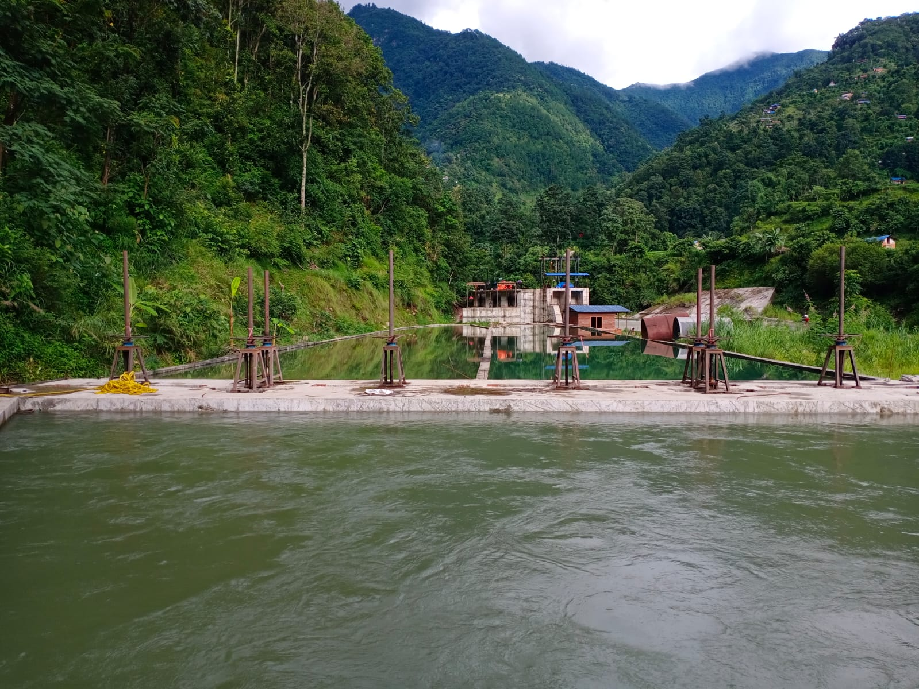
WELCOME TO PRESENTATION
ON
PRESENT STATUS
OF
DARAM KHOLA HYDROELECTRIC PROJECT (9.6 MW)

Slide 3


CONTENT
Present status Civil work
Present status Hydro-mechanical and Electro-mechanical
Transmission line and loop in out arrangement
Work schedule
Critical path and area
Revised BoQs and Cost Overrun
Progress Report

Slide 4
Construction Team
Developer : Daram Khola Hydro Energy Ltd.
Consultant : Units Engineering Consultancy Pvt. Ltd.
Civil Contractor : Ramechhap Sherpa Construction Pvt. Ltd & Nation Builders Pvt. Ltd.
H/M Contractor: CREAM Hydel Pvt. Ltd.
E/M Contractor/Supplier : Flovel Energy Pvt. Ltd.
Developer , Consultant and Contractor

Slide 5
PRESENT STATUS Contd…
HEADWORKS
All About 100% works on Headworks has been completed
Civil works on weir, intake, Under sluice, gravel trap, approach canal, settling basin, and protection related works has been completed.
Camp facility for staff at headworks works is on progress and will be completed soon.
CIVIL WORK
Headworks

Slide 6
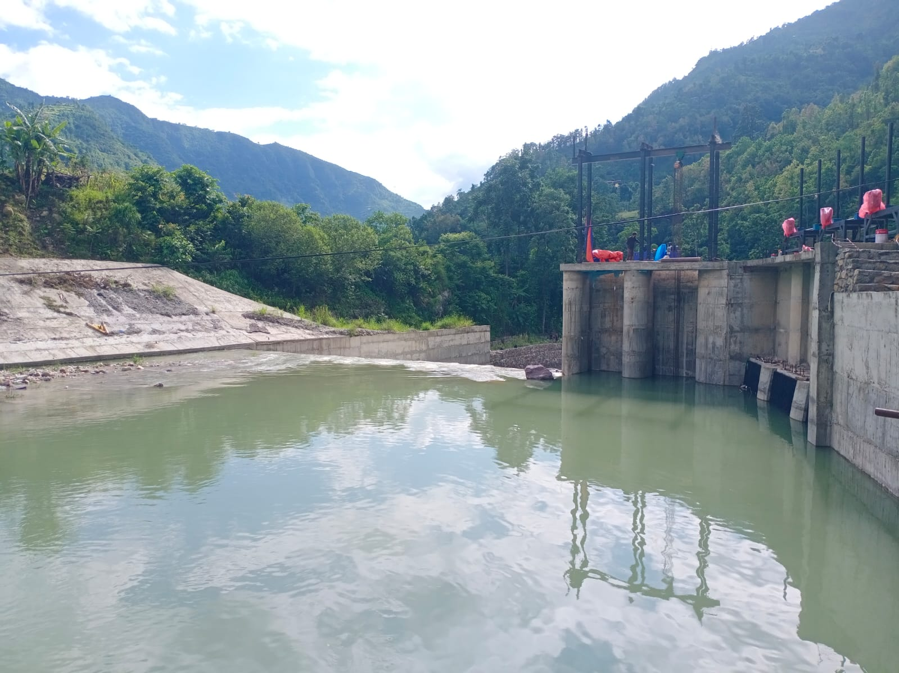

PRESENT STATUS Contd…
CIVIL WORK
Headworks
Photograph of Headworks with intake, undersluice, weir.

Slide 7
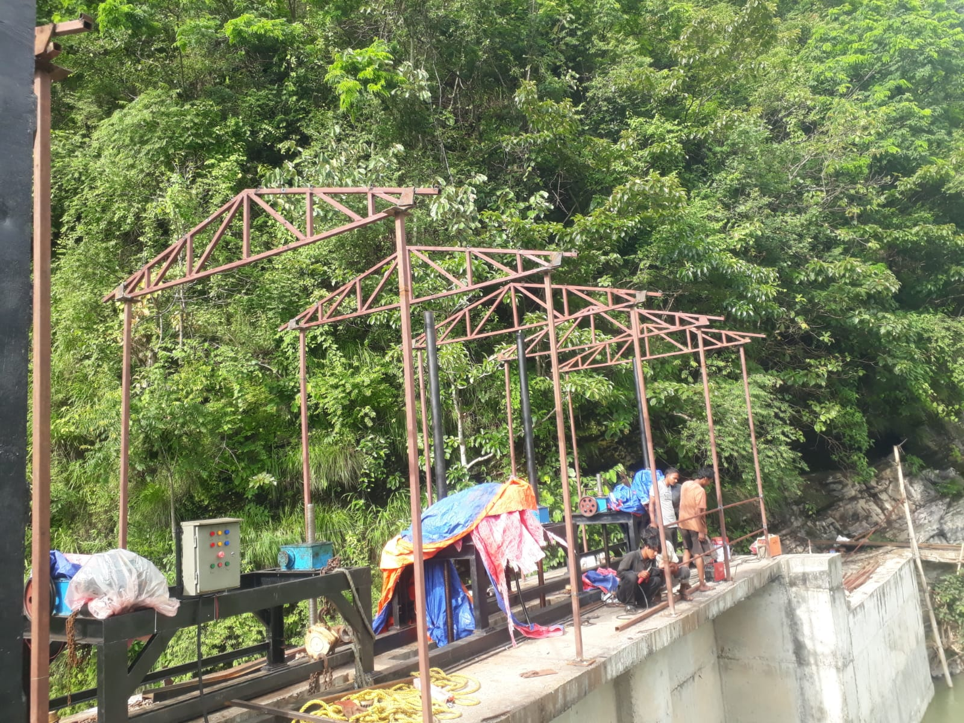
PRESENT STATUS Contd…
CIVIL WORK
Headworks
Photograph of Intake truss installation on progress

Slide 8
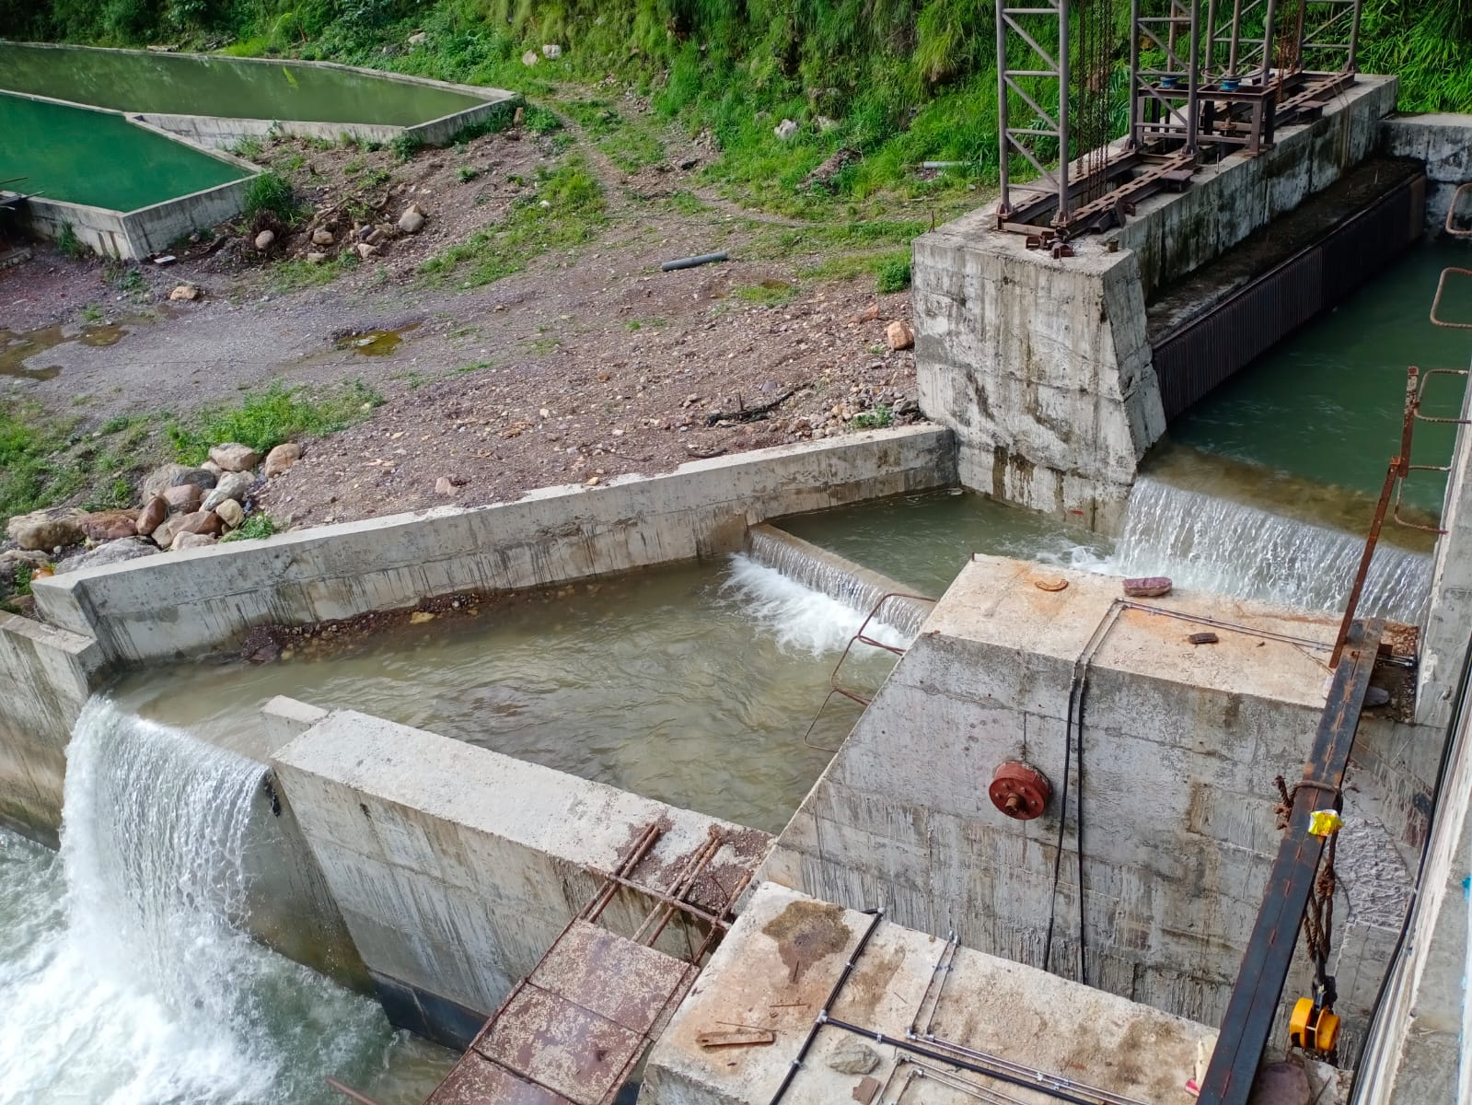
PRESENT STATUS Contd…
CIVIL WORK
Headworks
Photograph of Gravel Trap and Spillway

Slide 9
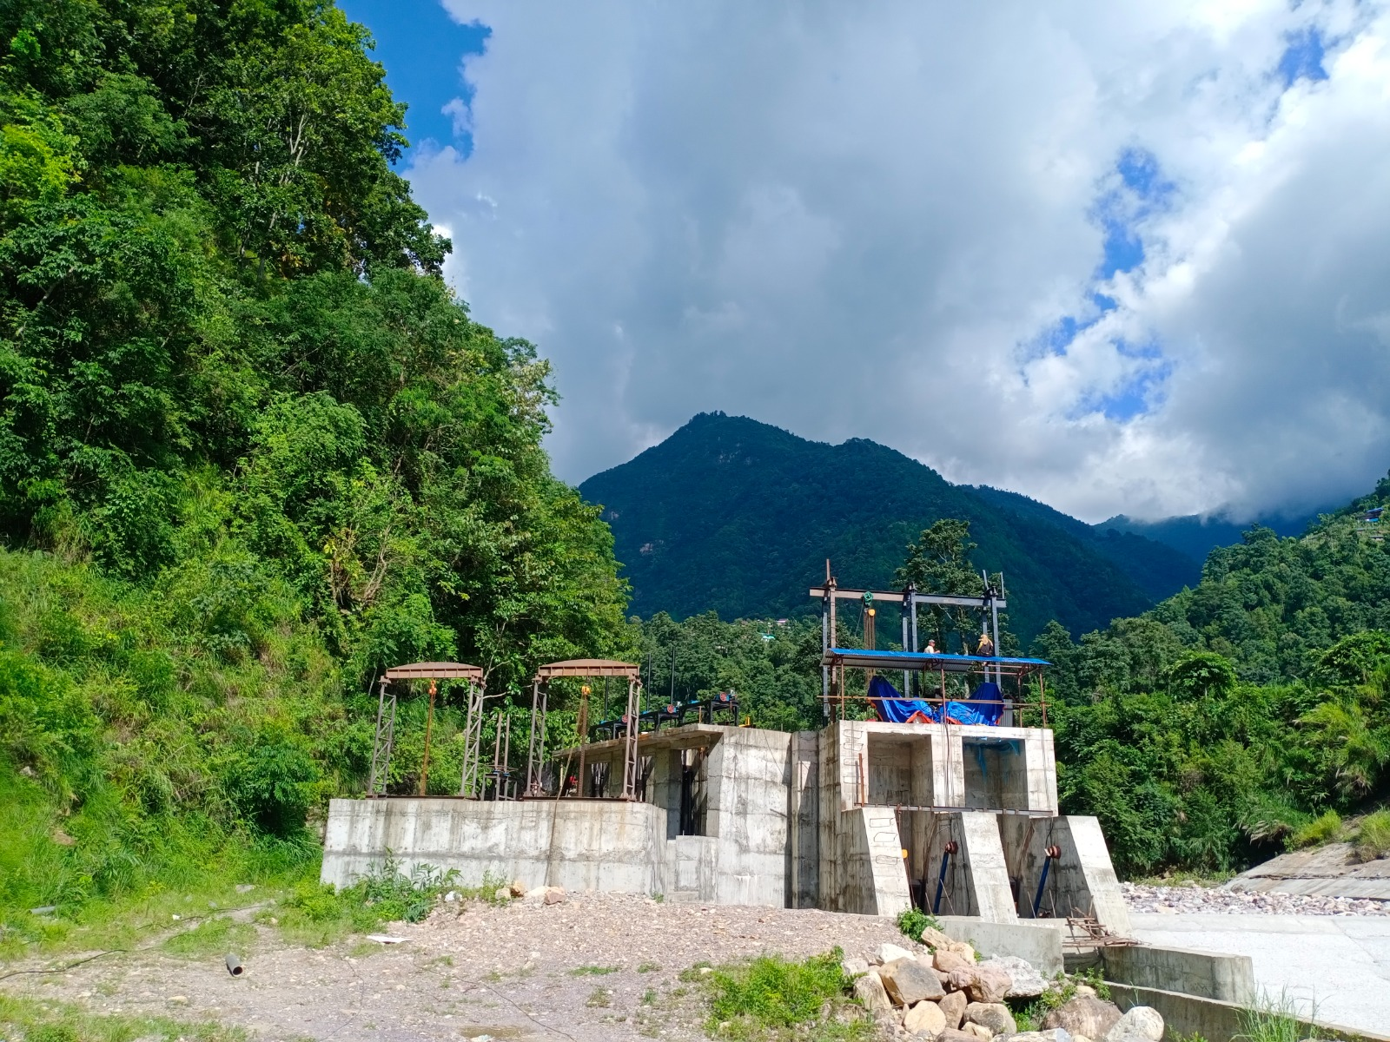
PRESENT STATUS Contd…
CIVIL WORK
Headworks
Photograph of Undersluice

Slide 10
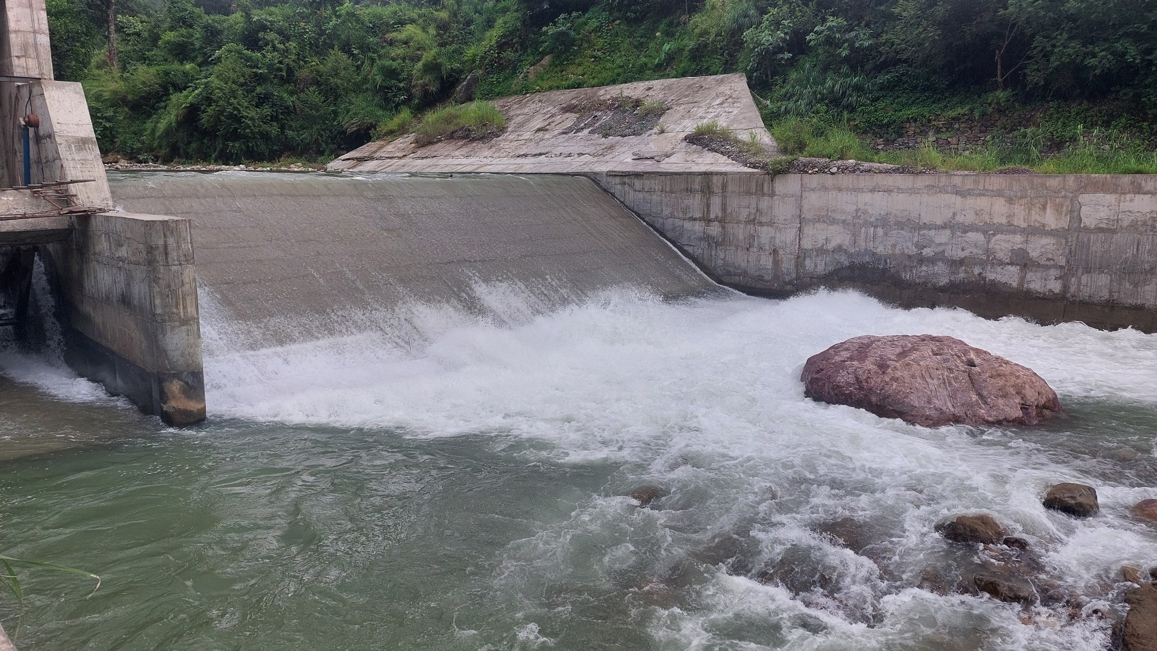
PRESENT STATUS Contd…
CIVIL WORK
Headworks
Photograph of Diversion Weir

Slide 11
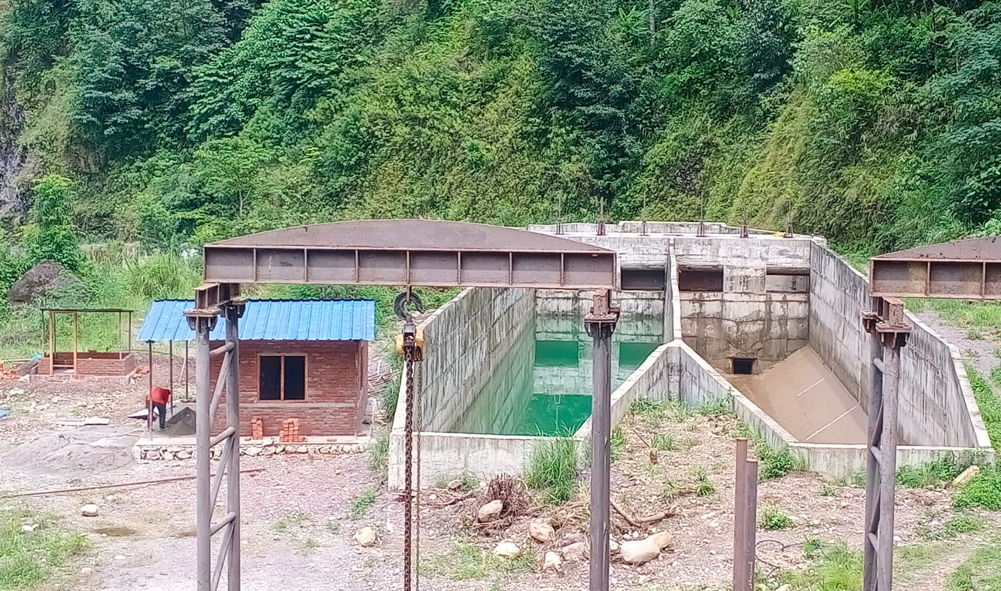
PRESENT STATUS Contd…
CIVIL WORK
Headworks
Photograph of Settling Basin along with headworks camp

Slide 12
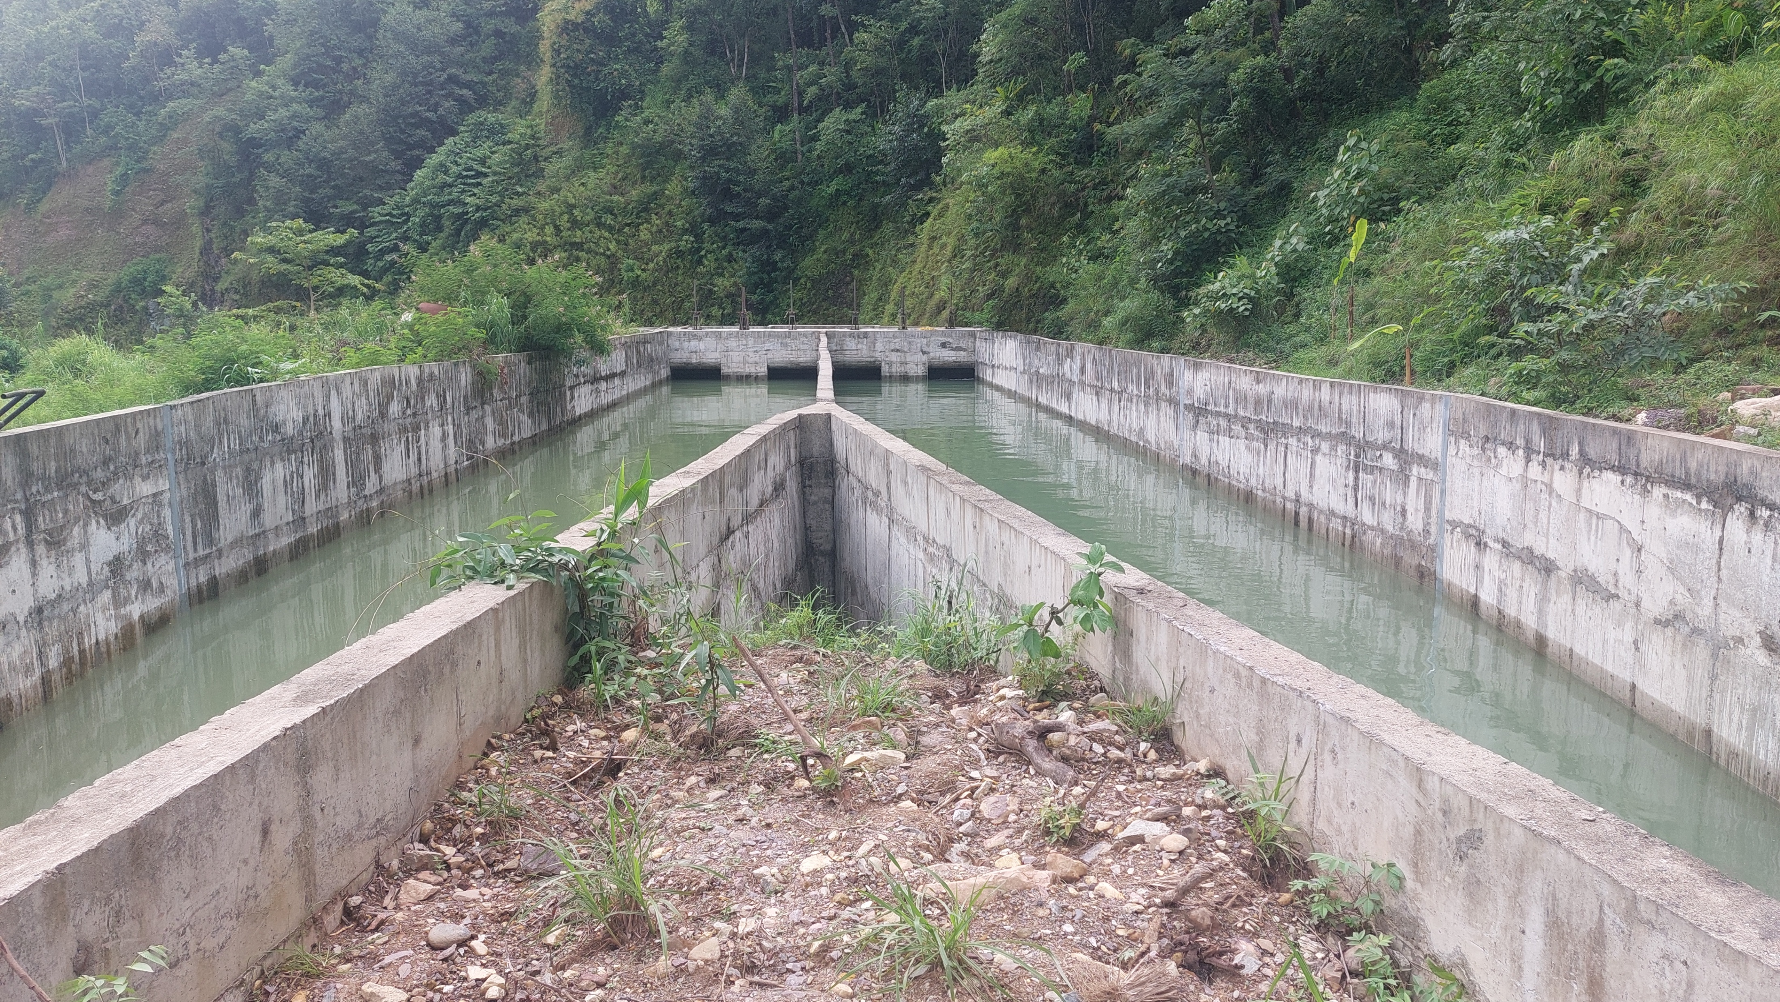
PRESENT STATUS Contd…
CIVIL WORK
Headworks
Photograph of Settling Basin During Static Water Filling Tests

Slide 13
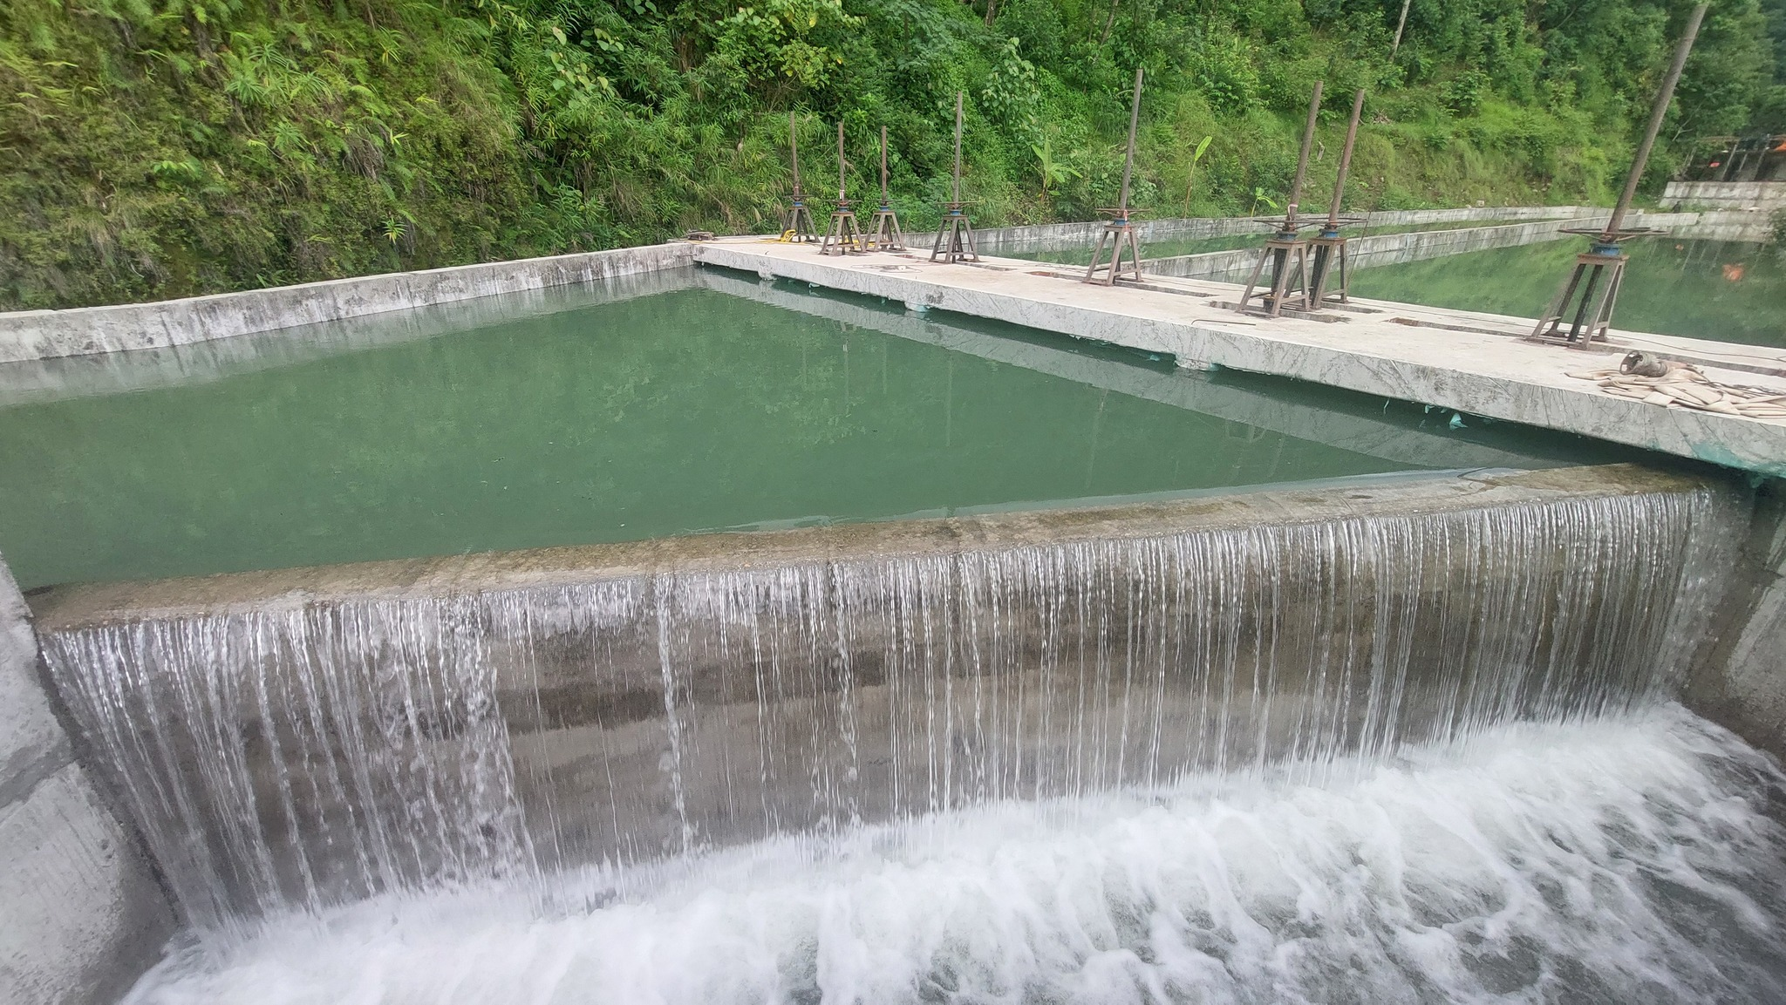
PRESENT STATUS Contd…
CIVIL WORK
Headworks
Photograph of First Spilling from Headpond after Static Water Filling tests

Slide 14
PRESENT STATUS Contd…
CIVIL WORK
Headworks
Photograph of Headpond and Settling Basin during Testing of Penstock Pipe and Wet test of EM Equipment at powerhouse

Slide 15
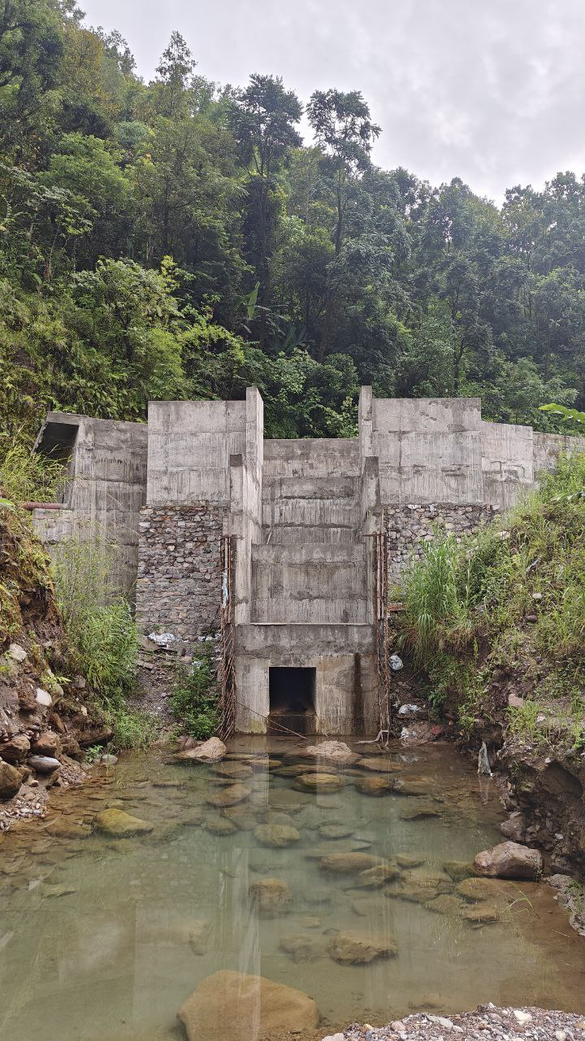
PRESENT STATUS Contd…
CIVIL WORK
Headworks
Photograph of Settling basin spillway

Slide 16
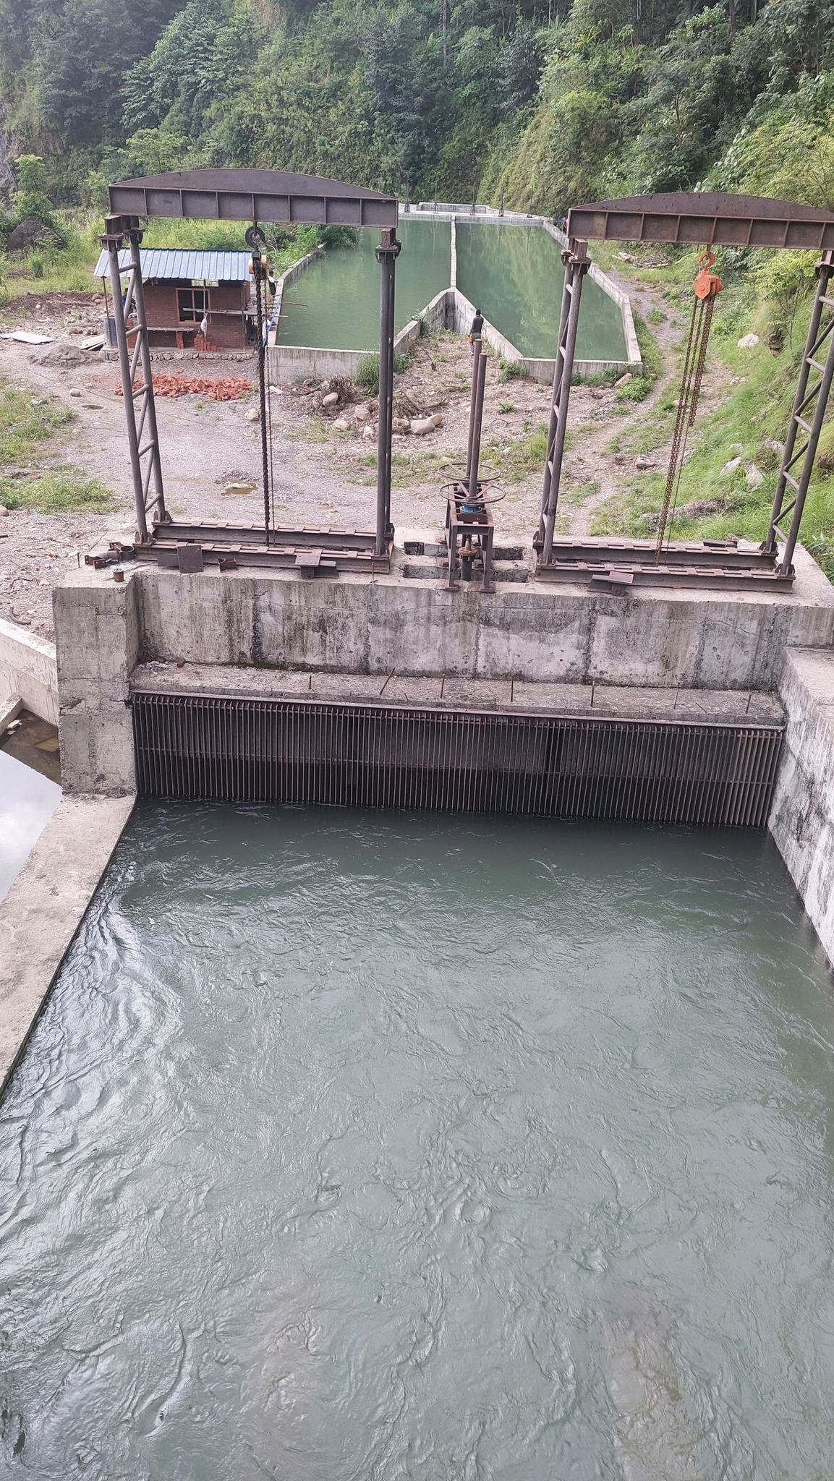
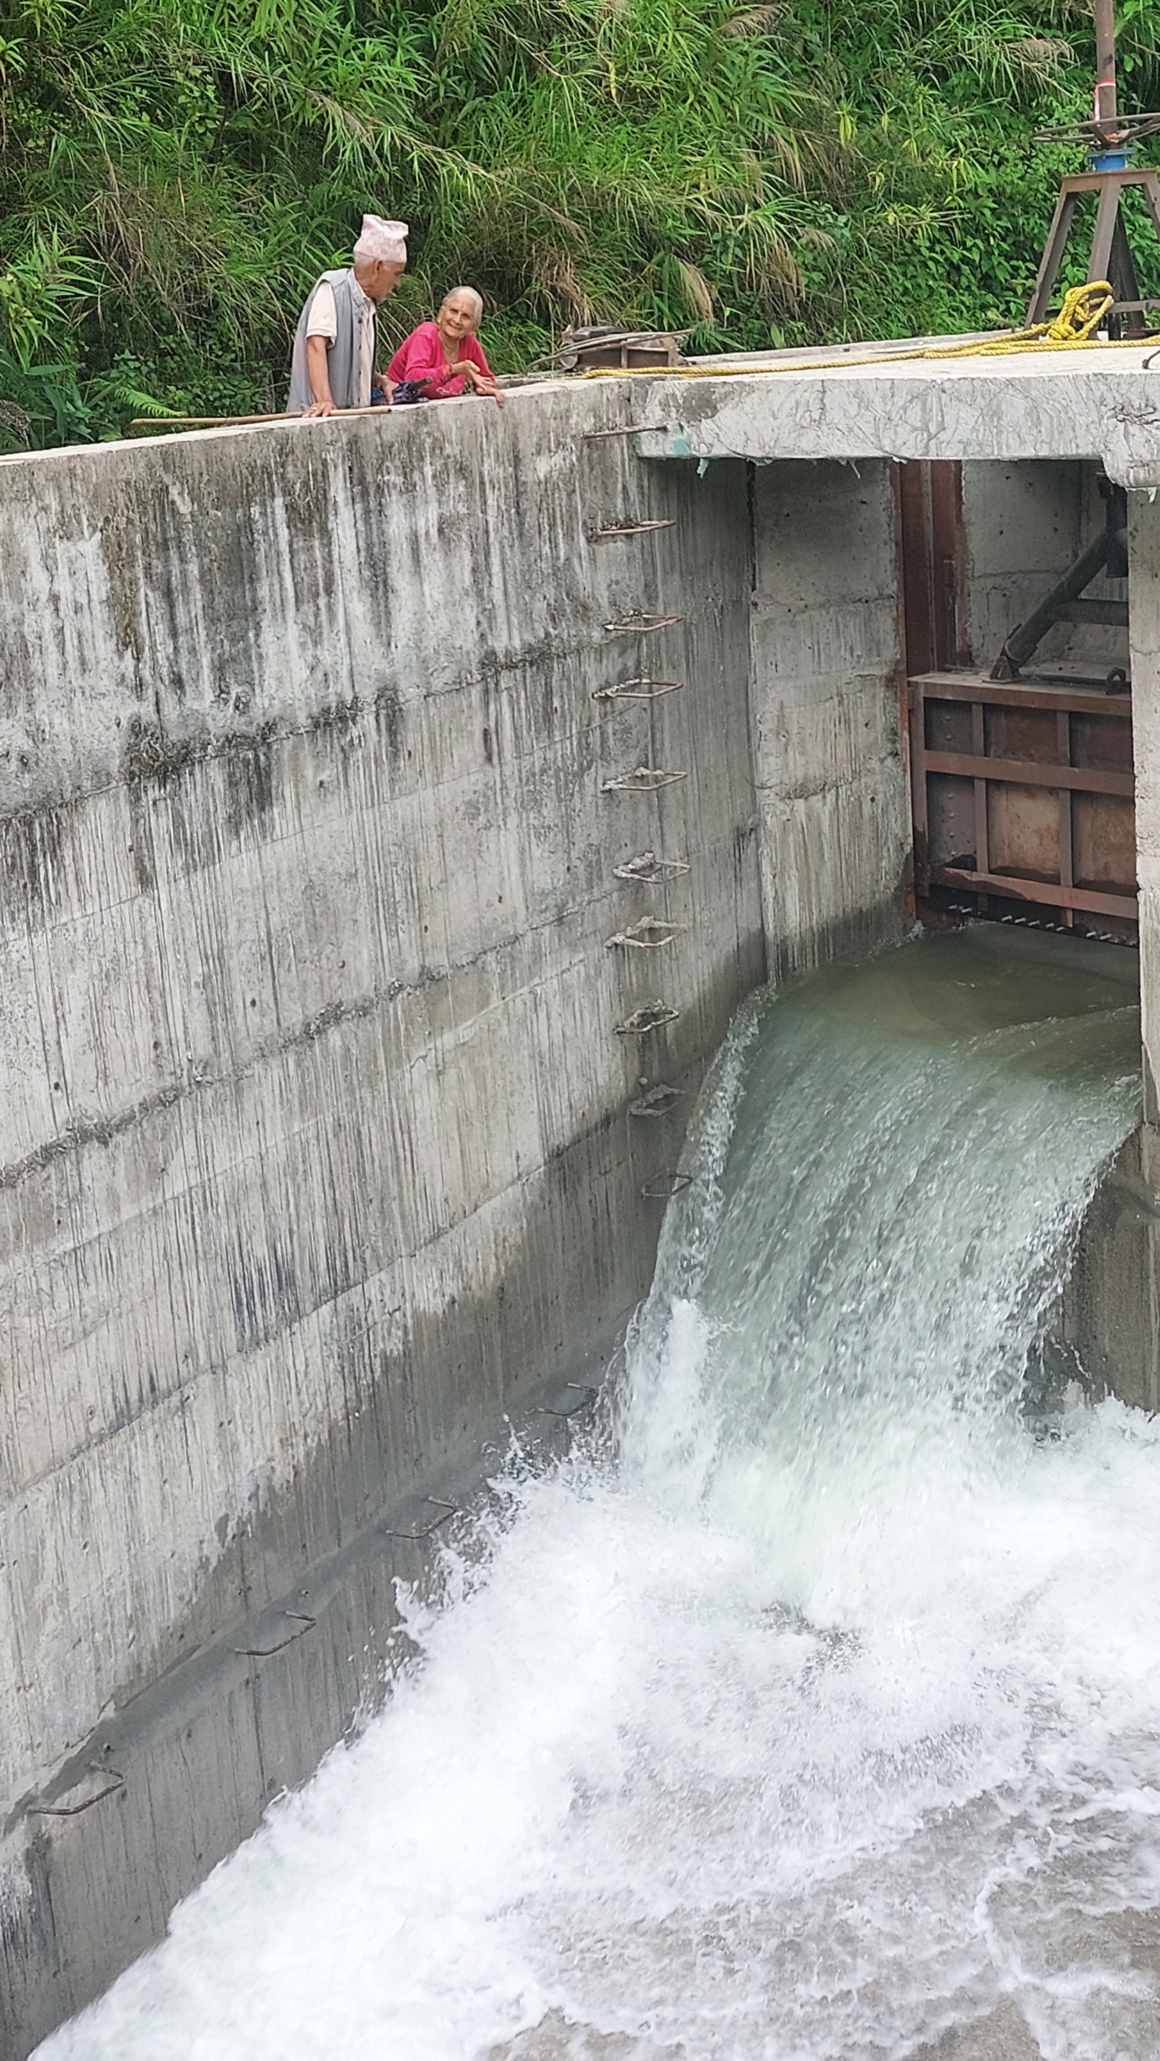
PRESENT STATUS Contd…
CIVIL WORK
Headworks
Photograph of Water Filling Tests

Slide 17
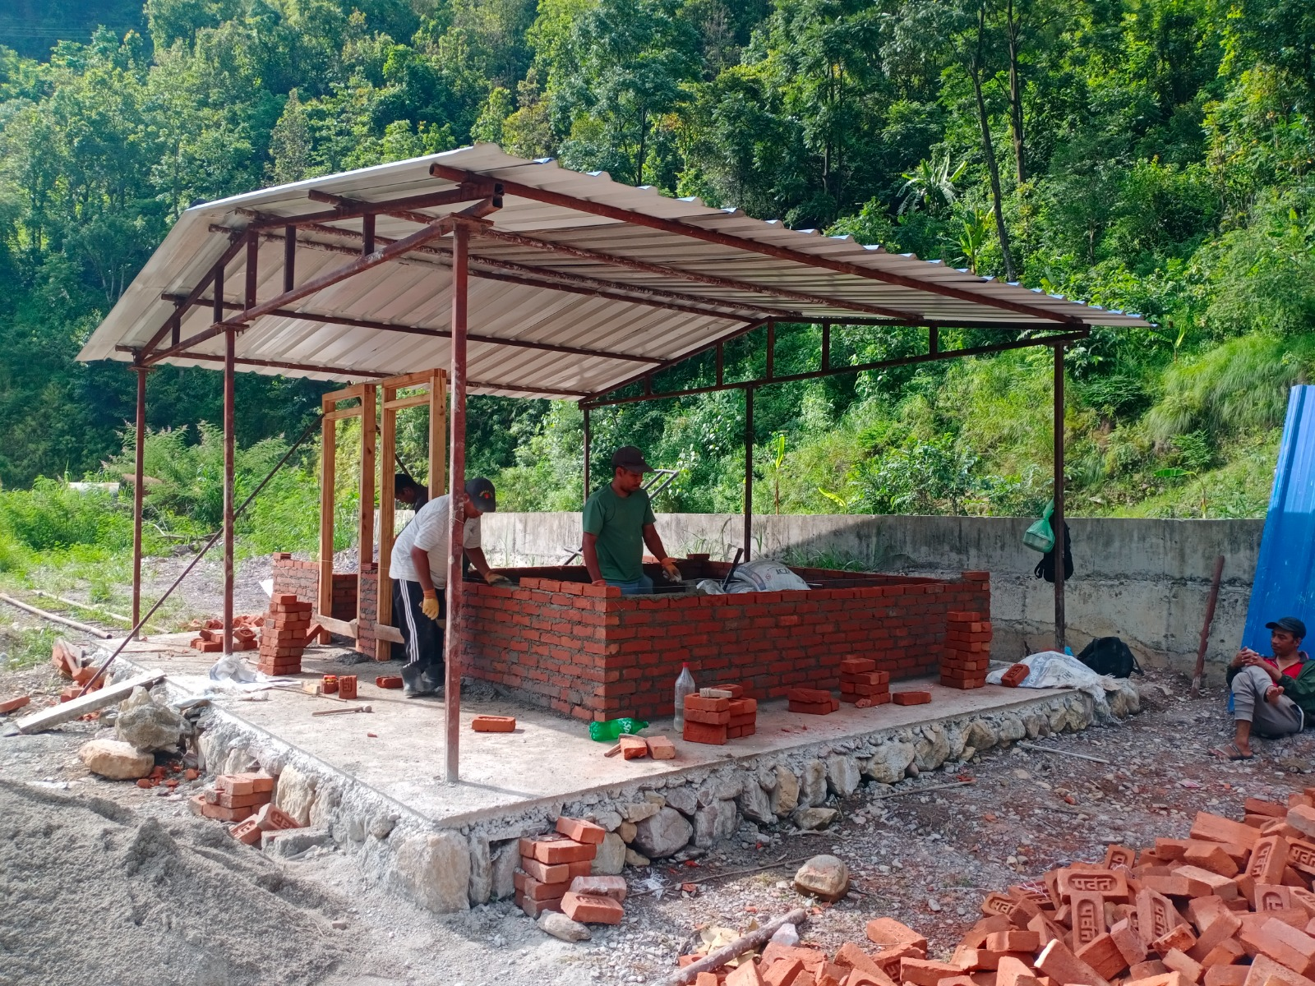
PRESENT STATUS Contd…
CIVIL WORK
Headworks
Photograph of Camp construction at Headworks

Slide 18
PRESENT STATUS Contd…
WATERWAYS
All about 100% of the civil works on waterway has been completed.
100% excavation works is completed and ongoing in remaining area.
100% of civil works for saddle supports has been completed.
50 nos. of Anchor Block out of 50 is completed.
Protection works are on-going as per site requirement. About 95% of estimated protection works along the alignment has been completed.
CIVIL WORK

Slide 19
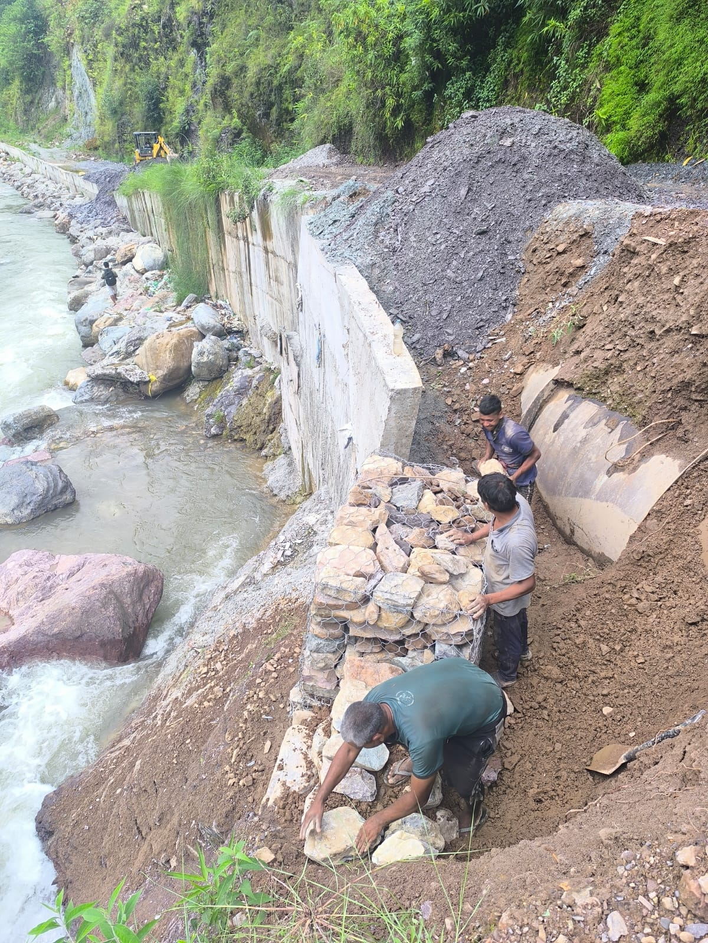
PRESENT STATUS Contd…
CIVIL WORKS
Waterway
Photograph in between IP1-IP2 (RCC & Gabion Protection Work)

Slide 20
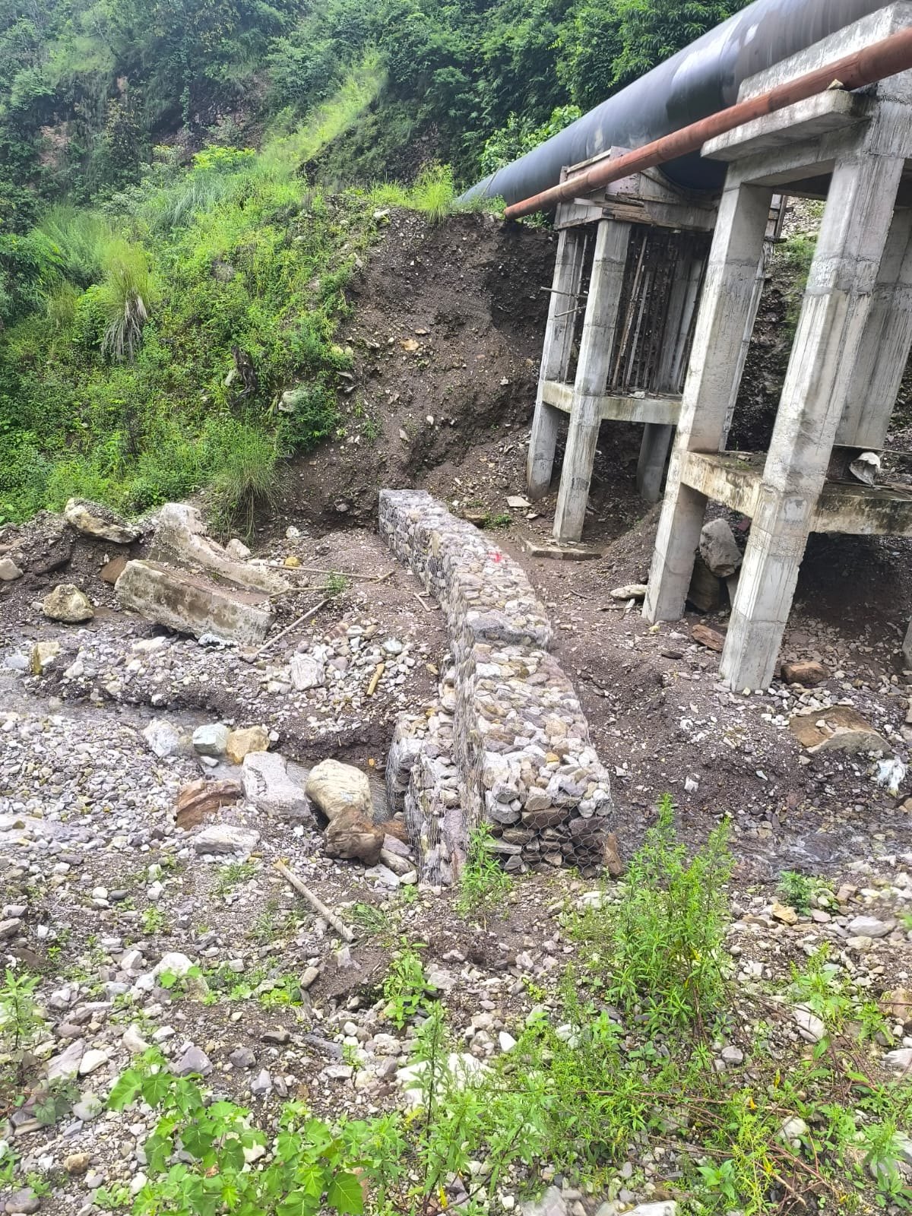
PRESENT STATUS Contd…
CIVIL WORKS
Waterway
Photograph of Gabion Protection & RCC of High saddle

Slide 21
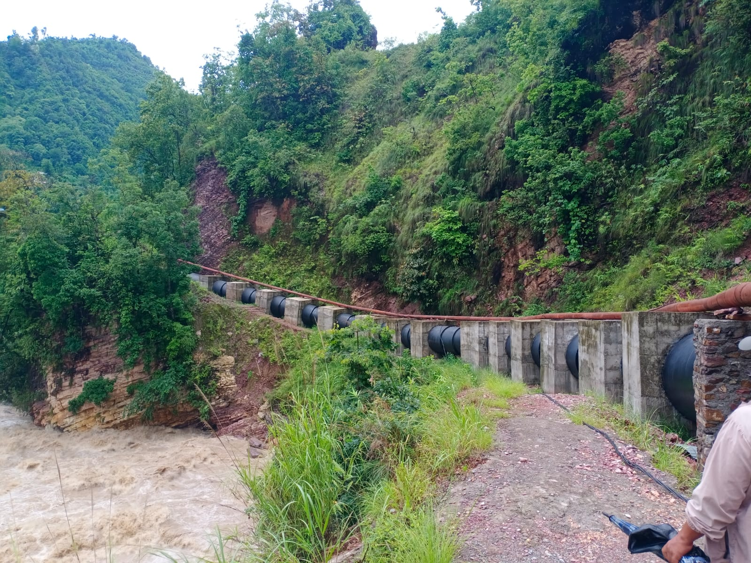
PRESENT STATUS Contd…
CIVIL WORKS
Waterway
Photograph of Blocks between AB12-AB17

Slide 22
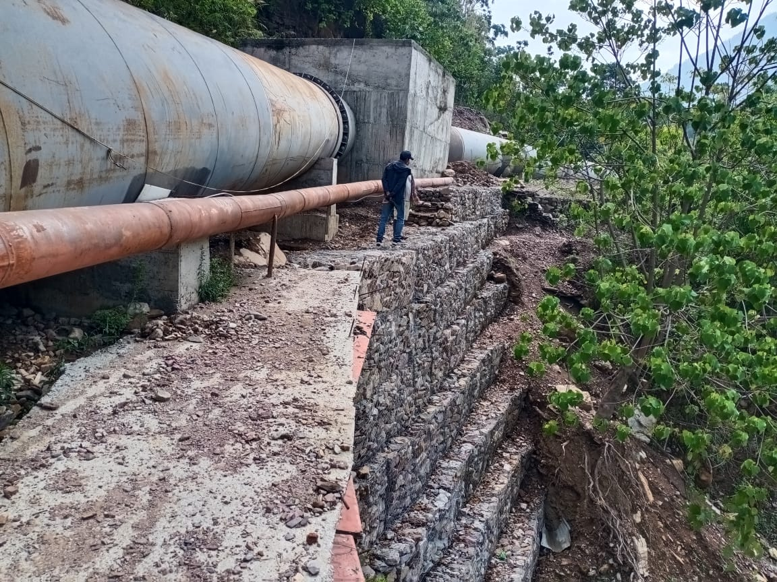
PRESENT STATUS Contd…
CIVIL WORKS
Waterway
Photograph of Gabion Protection Work at IP11-IP12

Slide 23
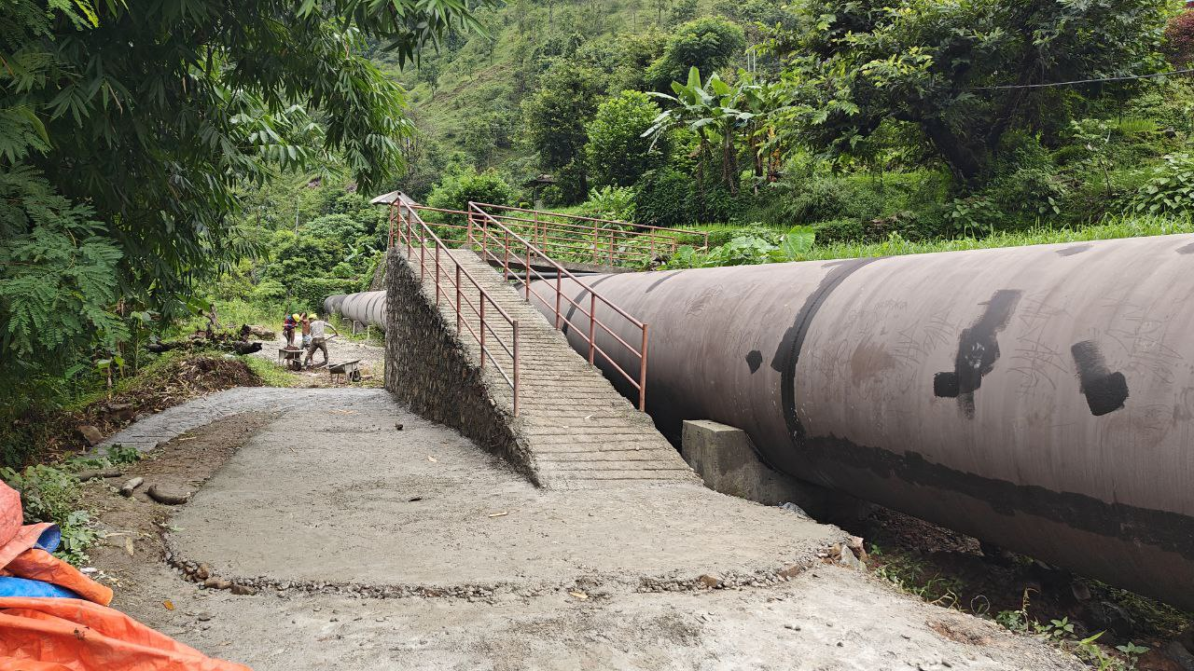
PRESENT STATUS Contd…
CIVIL WORKS
Waterway
Photograph of Pipe crossing for local people

Slide 24
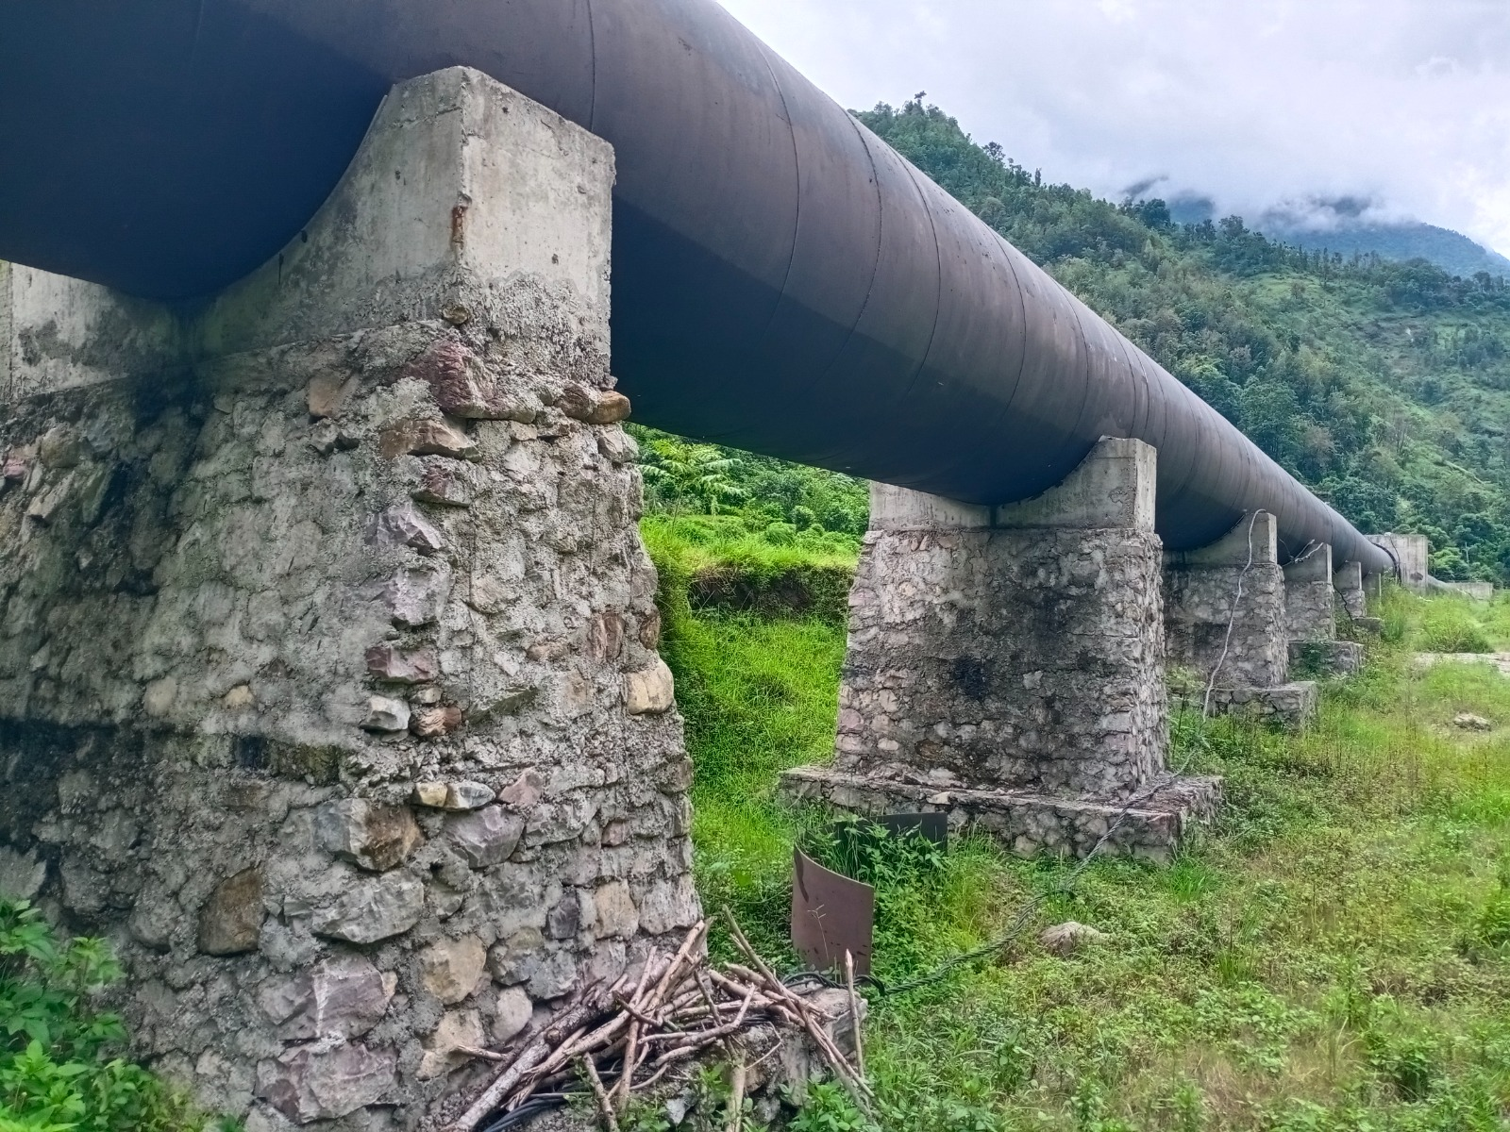
PRESENT STATUS Contd…
CIVIL WORKS
Waterway
Photograph of Saddle supports IP28-IP29.

Slide 25
PRESENT STATUS Contd…
SURGE TANK
Civil works construction of surge shaft is completed along with surge alignment.
Roof truss and backfilling works has been also completed.
Protection works is about to complete.
CIVIL WORK
Surge Tank

Slide 26
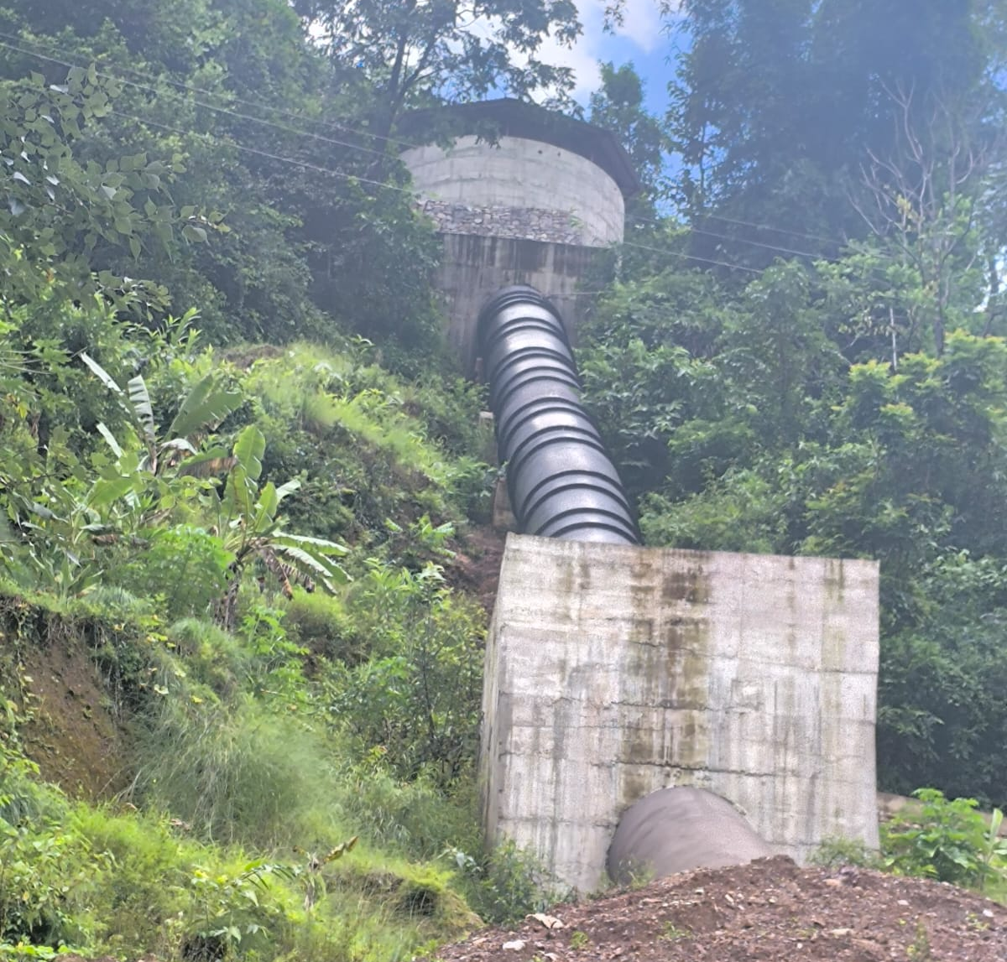
PRESENT STATUS Contd…
CIVIL WORKS
Waterway
Photograph of Stone masonary protection work at ST2-ST3

Slide 27
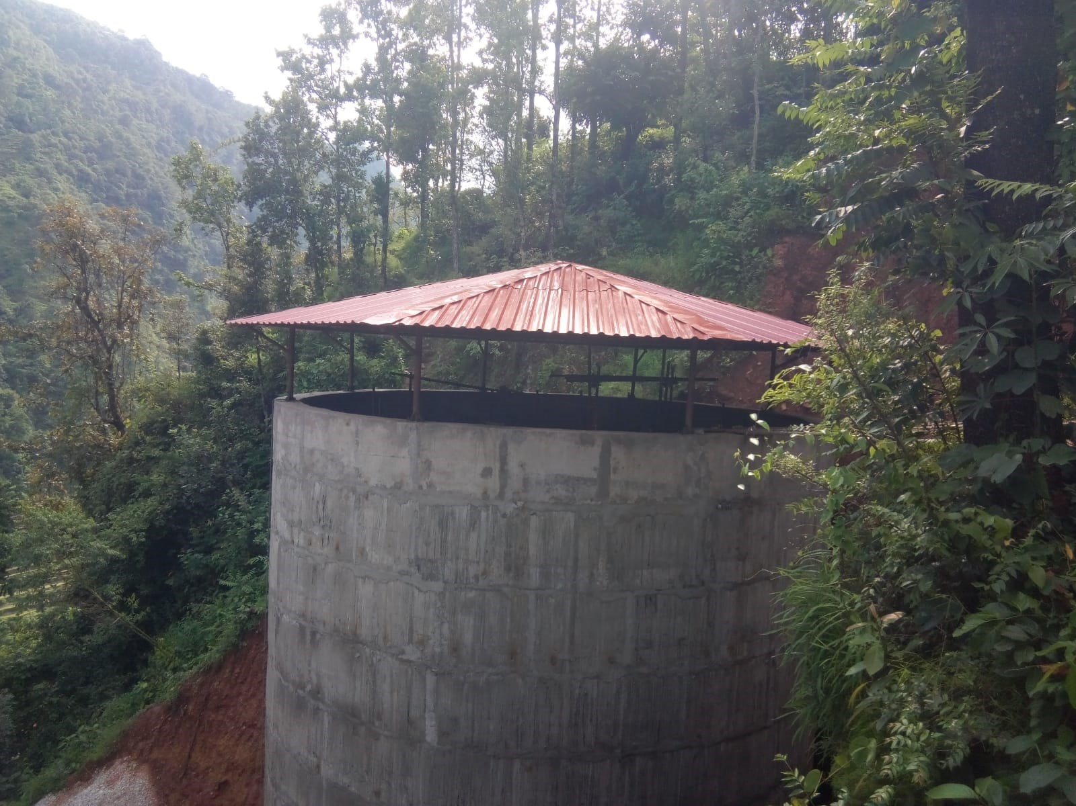
PRESENT STATUS Contd…
CIVIL WORKS
Surge tank
Photograph of surge shaft with roof truss.

Slide 28
PRESENT STATUS Contd…
POWERHOUSE, TAILRACE & PROTECTION WORKS
About 100% of powerhouse & control room civil works has been completed
All Powerhouse concrete structure related works is completed along with backfilling & truss installation.
Civil works of control room also has been completed.
Civil works of tailrace both unit has been completed.
Protection wall works for switchyard and powerhouse has also been completed.
CIVIL WORK
Powerhouse

Slide 29
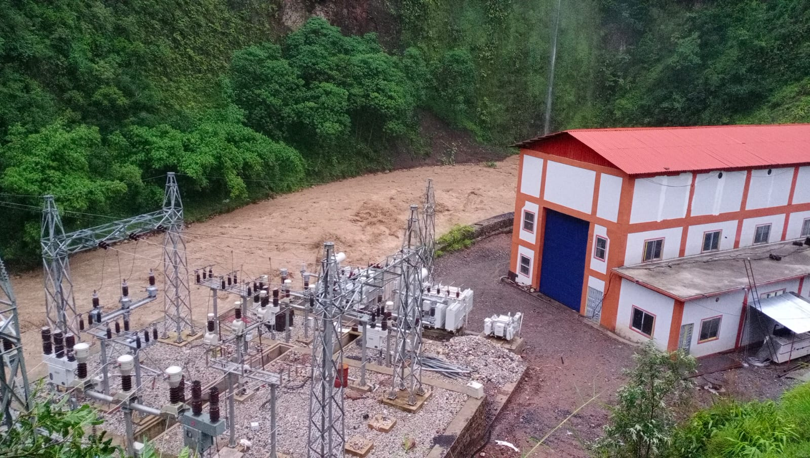
PRESENT STATUS Contd…
CIVIL WORKS
Power House
Photograph of Powerhouse, Control Room & switchyard area

Slide 30
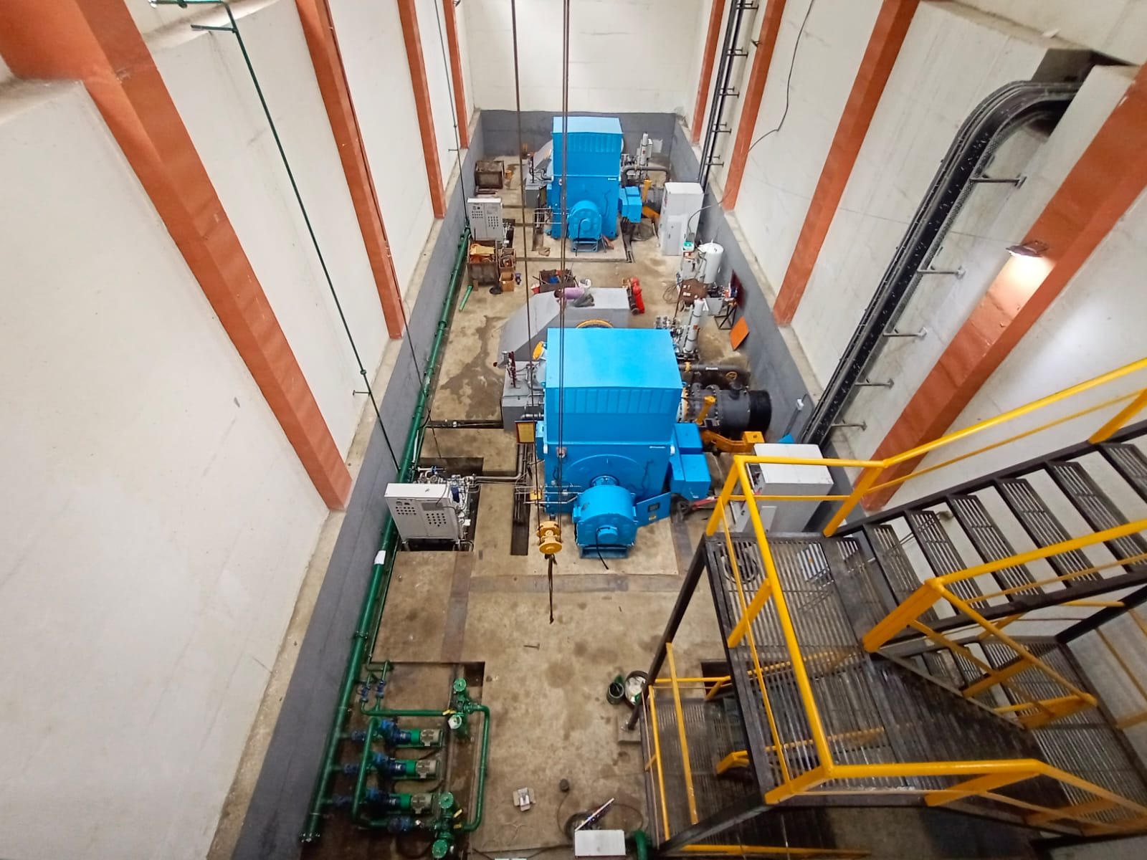
PRESENT STATUS Contd…
CIVIL WORKS
Power House
Photograph of Inside view of Powerhouse

Slide 31
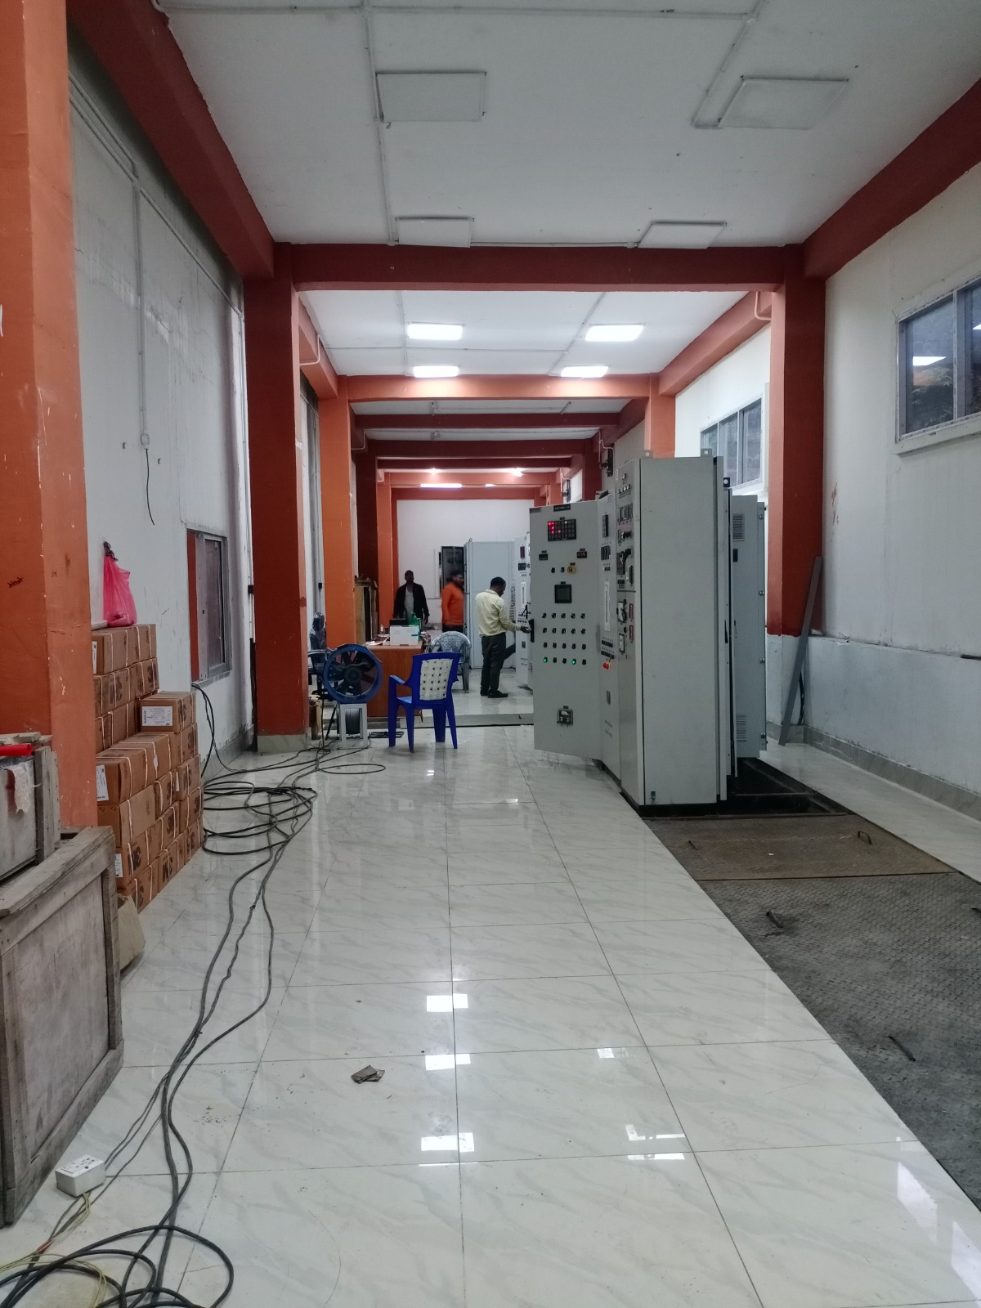
PRESENT STATUS Contd…
CIVIL WORKS
Power House
Photograph of Inside view of control room

Slide 32
PRESENT STATUS Contd…
HEADWORKS:
Installation of gate frames is completed at intake, under sluice, approach canal, gravel flushing & desander outlet. Radial gate frame is also installed.
Installation of stoplog frames is completed at all sections i.e. under sluice, Intake gate, gravel flushing & sand flushing.
Radial gate hydraulic system installation is about to complete.
Trash rack frame installation is completed at intake, approach canal & headpond.
Bellmouth installation at headpond is also completed.
Installation of intake, approach canal gate leaf is completed & stoplog leaf is erected at Undersluice & gravel flushing.
About 95% of Hydromechanical works at headworks is completed.
HYDROMECHANICAL WORK

Slide 33
PRESENT STATUS Contd…
WATERWAYS:
Pipe erection, welding & testing has been completed at Water ways along with expansion joint erection, bend erection & saddle plate erection.
Almost 100% of Hydromechanical works at alignment has been completed along with hydraulic testing.
.
HYDROMECHANICAL WORK

Slide 34
PRESENT STATUS Contd…
POWERHOUSE & SURGE TANK
Complete erection of draft tube gate, installation of earth mat & risers has been completed.
Erection of embedded pipe beneath powerhouse & tailrace is also completed.
Surge cone erection is completed at surge tank by hydromechanical team.
Pipe erection at surge alignment has been completed.
HYDROMECHANICAL WORK

Slide 35
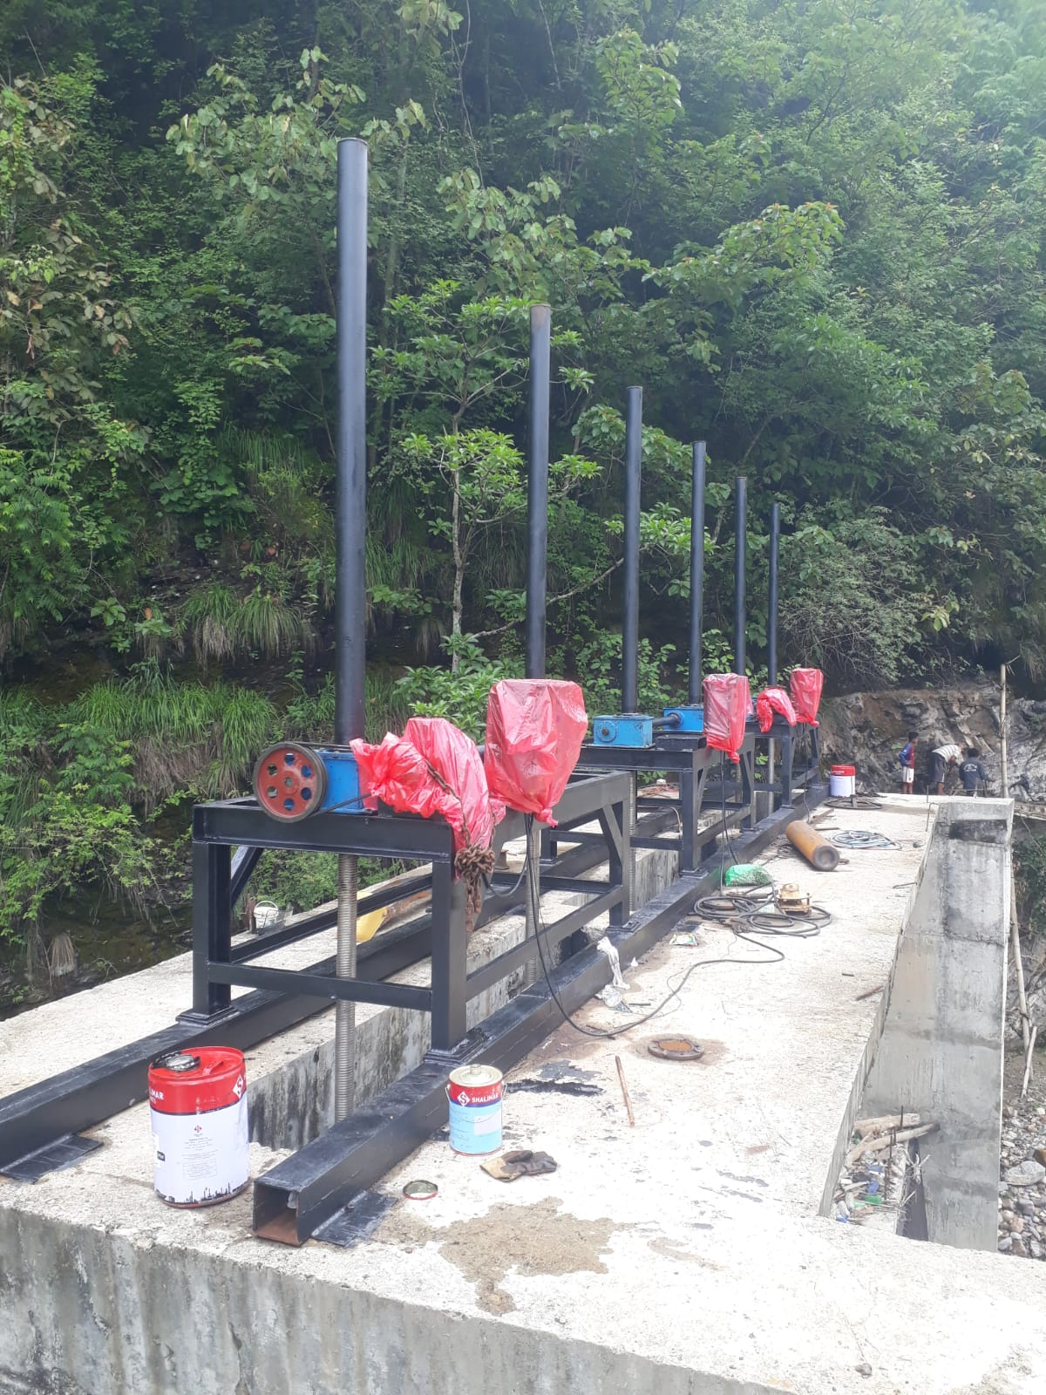
PRESENT STATUS Contd…
HM WORKS WATERWAYS
Intake gate electric hoisting system has been completely installed

Slide 36
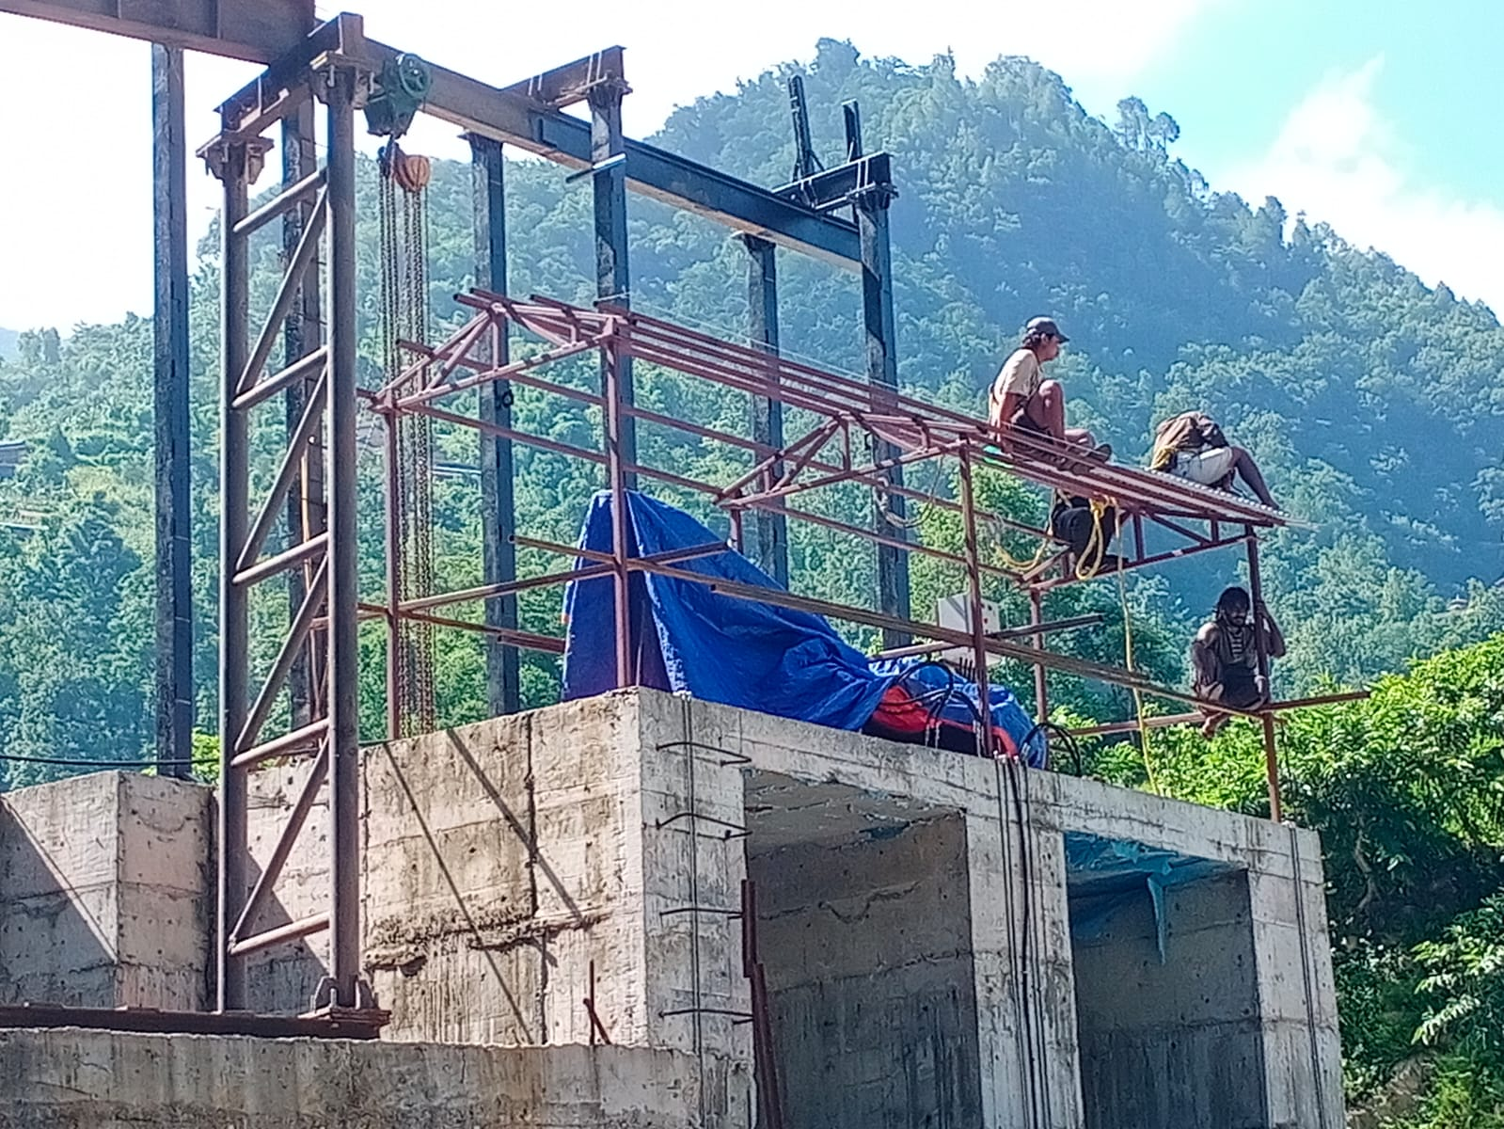
PRESENT STATUS Contd…
HM WORKS WATERWAYS
Truss installation work on progress

Slide 37
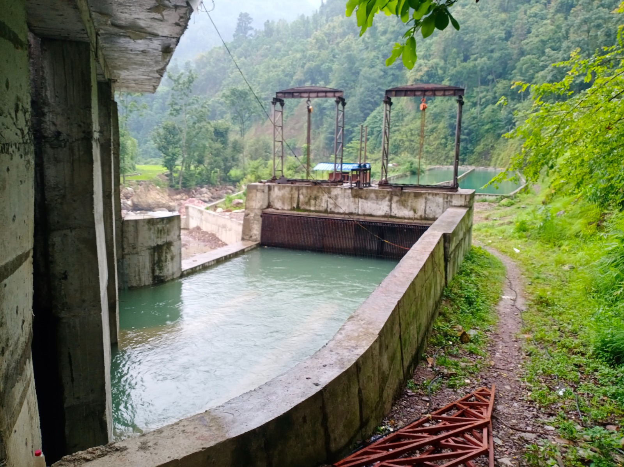
PRESENT STATUS Contd…
HYDROMECHANICAL WORK
Gravel flushing and approach canal gate installation completed

Slide 38
PRESENT STATUS Contd…
HYDROMECHANICAL WORK
Photograph of Intake truss installation on progress.

Slide 39
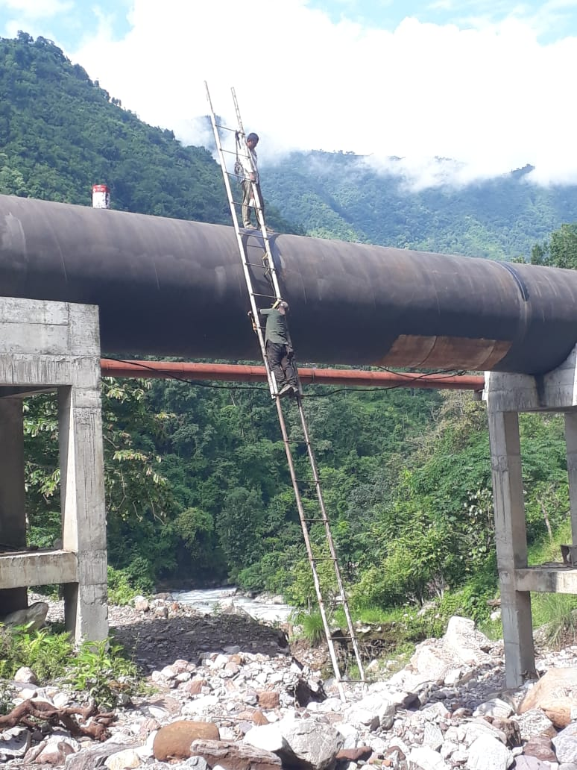
PRESENT STATUS Contd…
HYDROMECHANICAL WORK
Photograph of pipe painting works between IP10-IP11.

Slide 40
PRESENT STATUS Contd…
HYDROMECHANICAL WORK
Photograph of pipe Alignment at IP12-IP17.

Slide 41
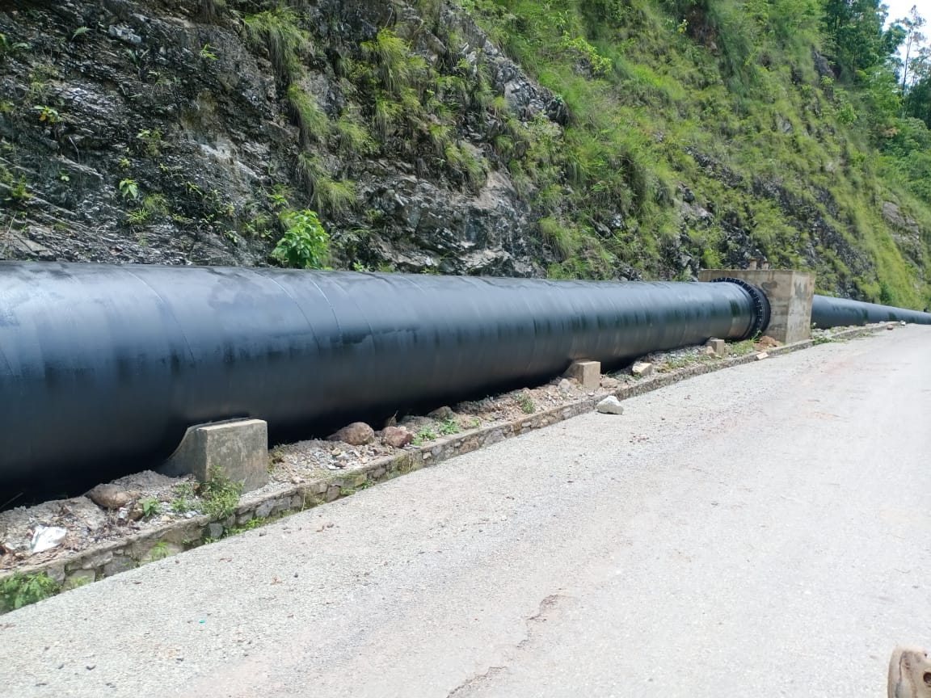
PRESENT STATUS Contd…
HYDROMECHANICAL WORK
Photograph of Pipe Alignment

Slide 42
PRESENT STATUS Contd…
Flovel Energy Pvt. Ltd. has been selected and awarded for design , manufacture, supply, installation, commissioning and testing of all Electromechanical Works.
Laying of earth mat and other embedded E/M parts like railing of crane beam at powerhouse is completed.
After flooded of EM equipment at powerhouse, the restoration work has been started and is on progress.
During restoration work about 85% of work has been completed and 15% work is pending due to EM equipment.
Mechanical spinning has been also carried out and was successful.
ELECROMEHANICAL WORK

Slide 43
PRESENT STATUS Contd…
ELECROMEHANICAL WORK
Photograph EM equipment installed at site

Slide 44
PRESENT STATUS Contd…
ELECROMEHANICAL WORK
Photograph EM equipment installed at control room

Slide 45
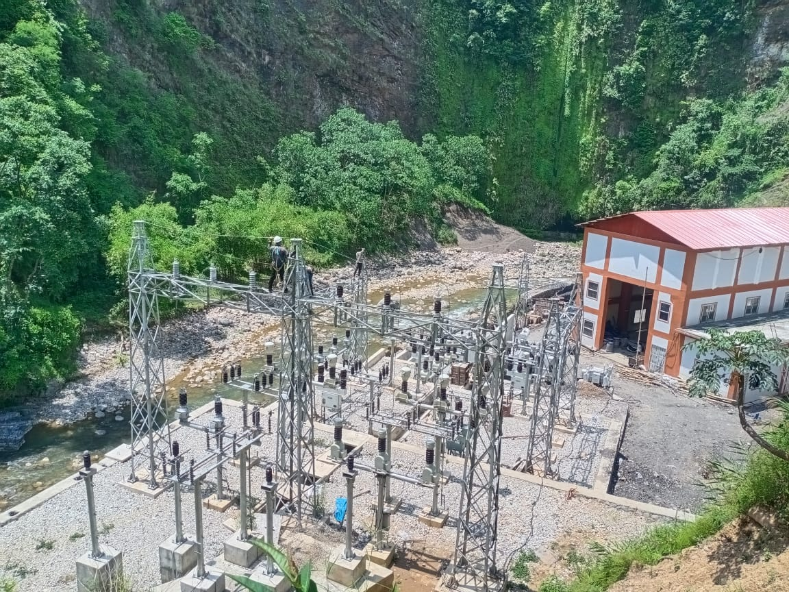
PRESENT STATUS Contd…
ELECROMEHANICAL WORK
Photograph EM equipment installed at Switchyard

Slide 46
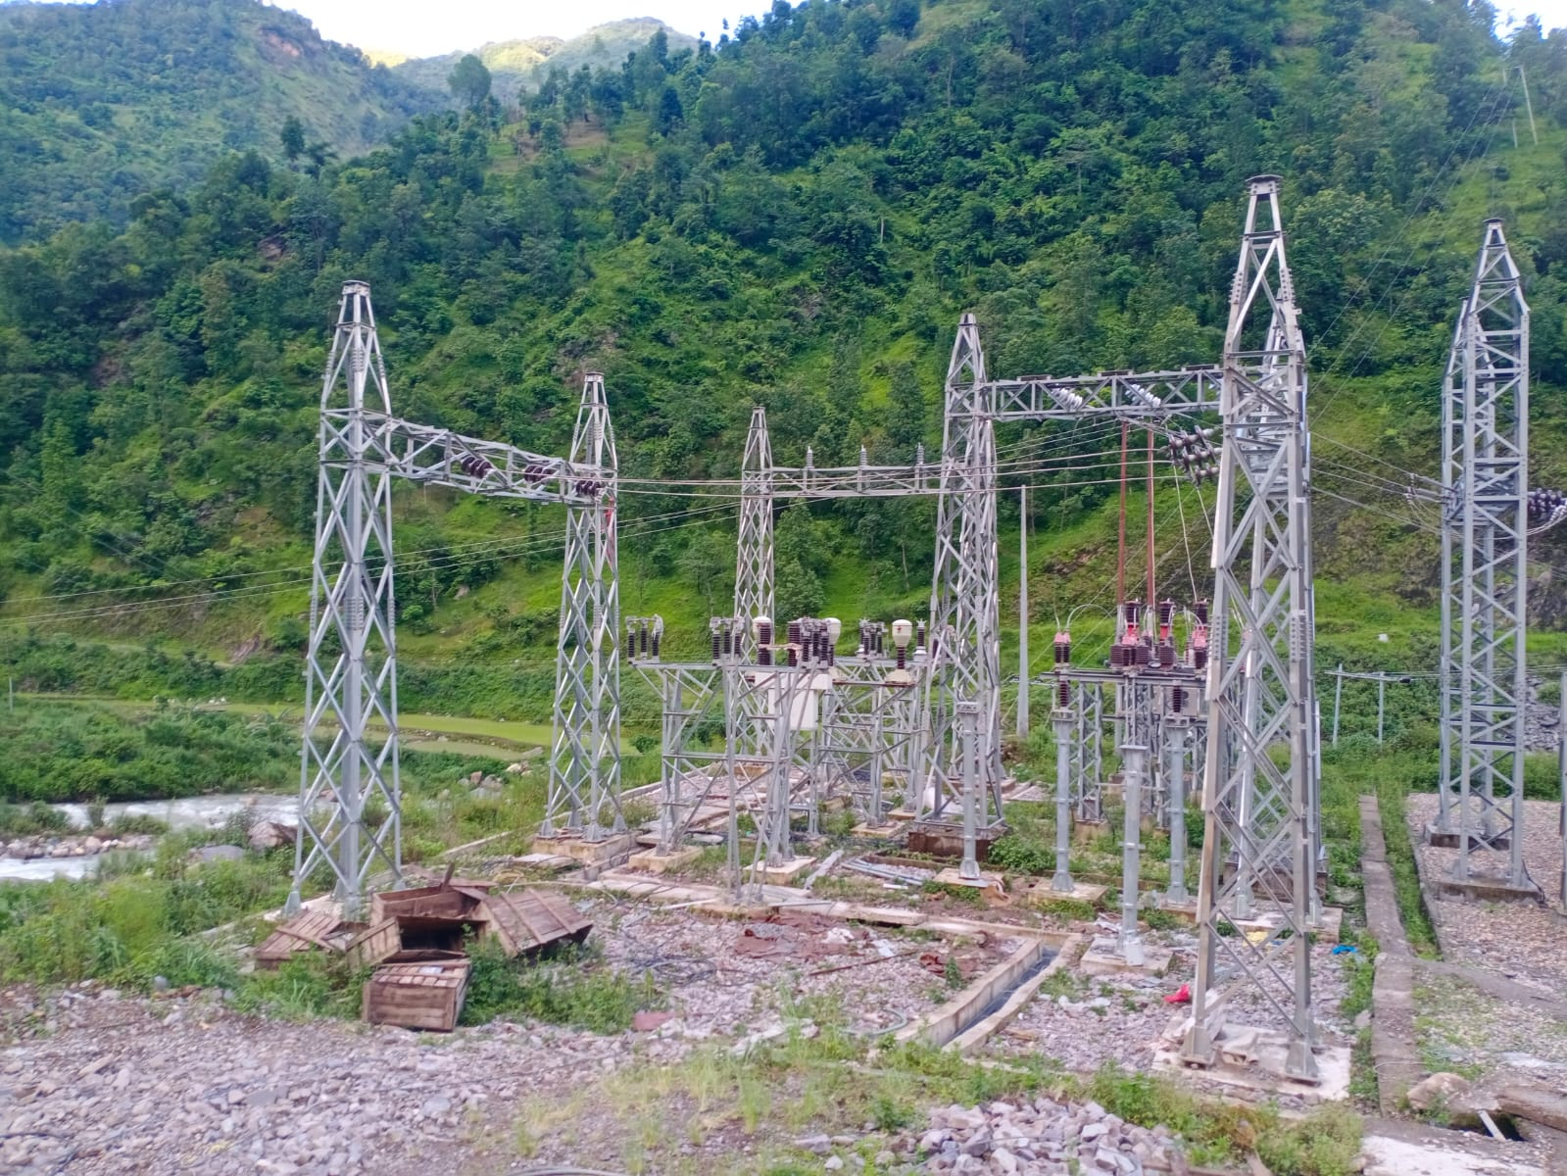
PRESENT STATUS Contd…
ELECROMEHANICAL WORK
Photograph EM equipment installed at Harichaur Substation

Slide 47
PRESENT STATUS Contd…
Total length of Transmission Pine is 14 km from Manewa to Harichaur.
About 95% of Transmission line work has been completed and further work is also about to complete.
Jumper connection and bush cutting work is on progress.
TRANSMISSION LINE

Slide 48
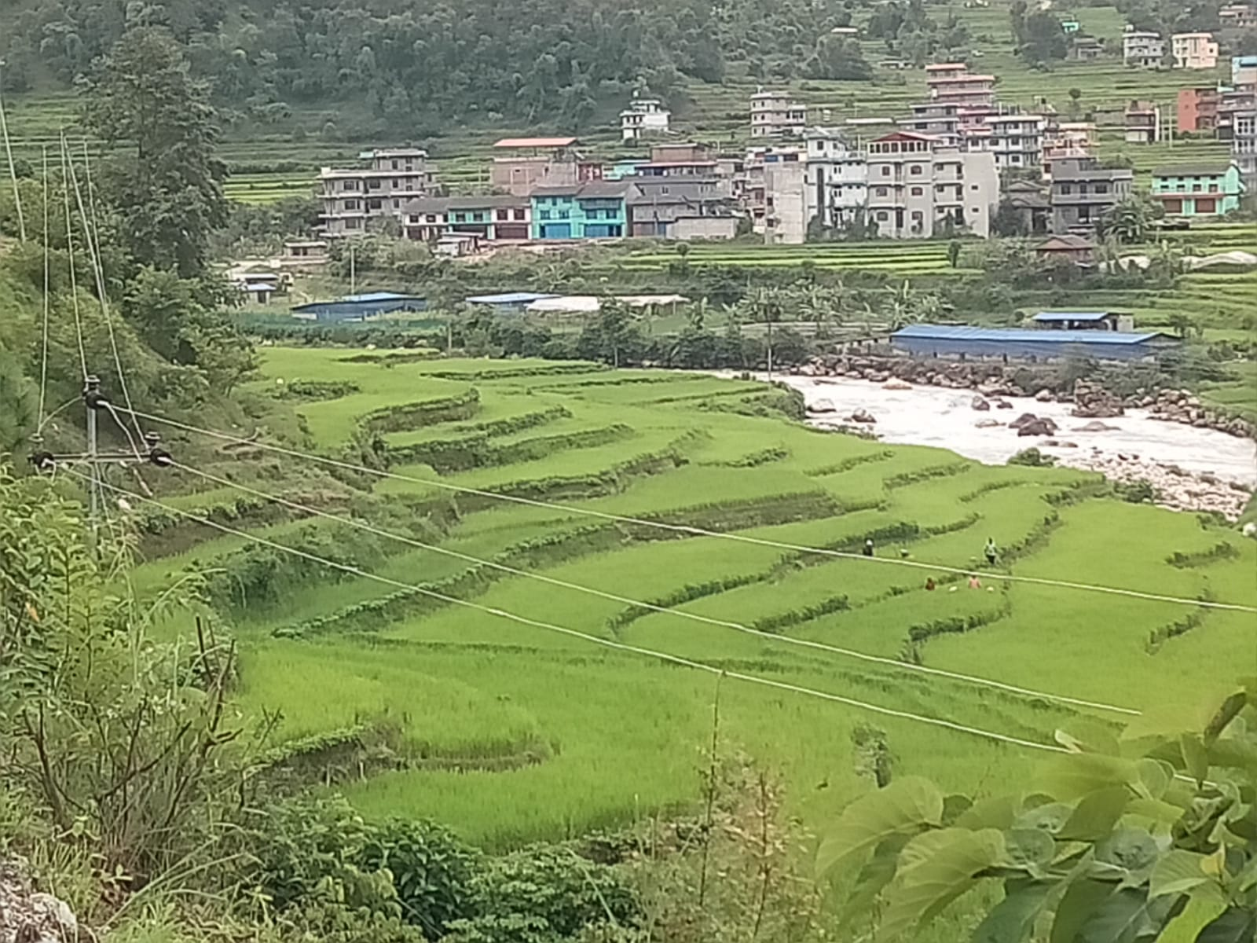
PRESENT STATUS Contd…
TRANSMISSION LINE
Photographs of transmission line progress

Slide 49
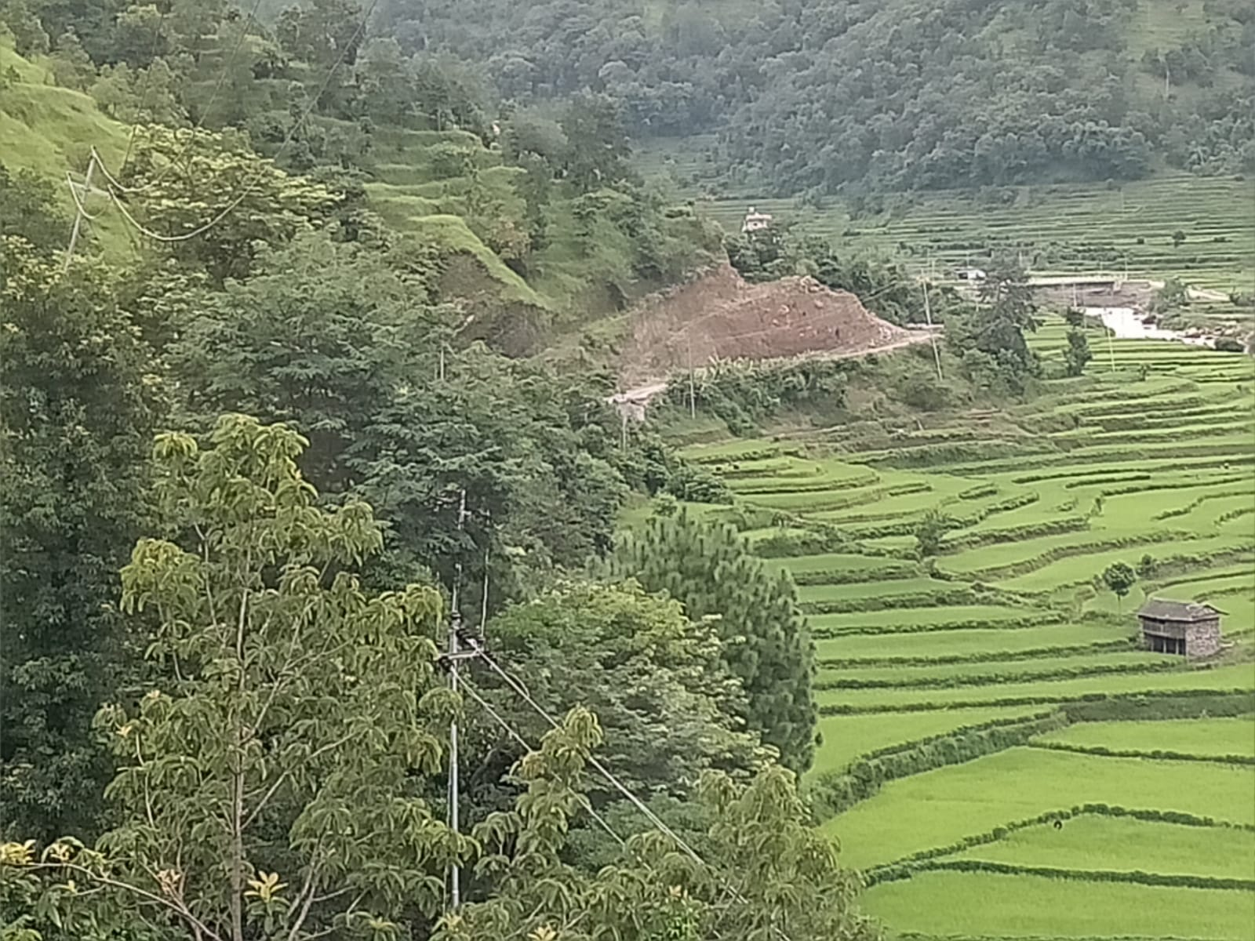
PRESENT STATUS Contd…
TRANSMISSION LINE
Photographs of transmission line progress

Slide 50
PRESENT STATUS Contd…
LILO equipment have already been installed at incoming bay.
Back charging will be done once the remaining works of TL completed.
LOOP IN LOOP OUT (LILO)

Slide 51
CONSTRUCTION PLAN
Construction Plan has been rescheduled for the remaining works.
Remaining Works:
  Jumper connection and bush cutting works: 8 days
  Communication system of SCADA system: 15 days from now
  Parts to be replaced in OPU: delivery time 4 days and replacement time 2-3 days
  Preparation of test reports:
  LILO and Transmission Line Charging: 1 day after TL works all complete
  Transformer Charging: 24 hours after Line Charging
  Wet Test, Synchronization and Load Tests: 1-2 days depending upon NEA requirements
  Trial run for 15 days (until the 80% of energy delivered to NEA)
  Targeted COD is on 18th September 2025 (2nd Aswin 2082)
CONSTRUCTION SCHEDULE

Slide 52
FINANCIAL STATUS
BUDGET UTILIZATION TILL ASHAD END, 2082

Slide 53
FINANCIAL STATUS
BUDGET REVISION SUMMARY SHEET (in Crore)
Request for Additional Loan: 12 Crore

Slide 54
FINANCIAL STATUS
Loan Status (in Crore)
Release of Bank Guarantee under progress.

Slide 55
FINANCIAL STATUS
LOAN AGAINST IPO STATUS
IPO will be listed up to Bhadra end.

Slide 56
Conclusion
  All the Civil and Hydromechanical works have been completed that prevents the plant for commissioning works.
  Static water filling works on civil and hydromechanical pipelines was successfully completed on 11th Shrawan 2082.
  Some of the HM works such as hoist sheds, and railing are under construction.
  Some of the EM equipment and parts such as damaged items of the OPU and the Communication panels are not received at site. Plant cannot be commissioned without replacement of OPU damaged items but Communication panel can be installed before COD.
  Remaining works on TL to be completed soon for line and transformer charging.
Summary of documentation and Physical progress

Slide 57
THANK YOU !!!

